Slide 1
National Schools Twenty20 competition
Finals day July 2016
Arundel Castle

Slide 2
Photographs
by
Patrick Eagar
© No images may be reproduced without permission

Slide 3
The first semi-final
Cranleigh v Millfield
Cranleigh in dark blue
Millfield in light blue

Slide 4
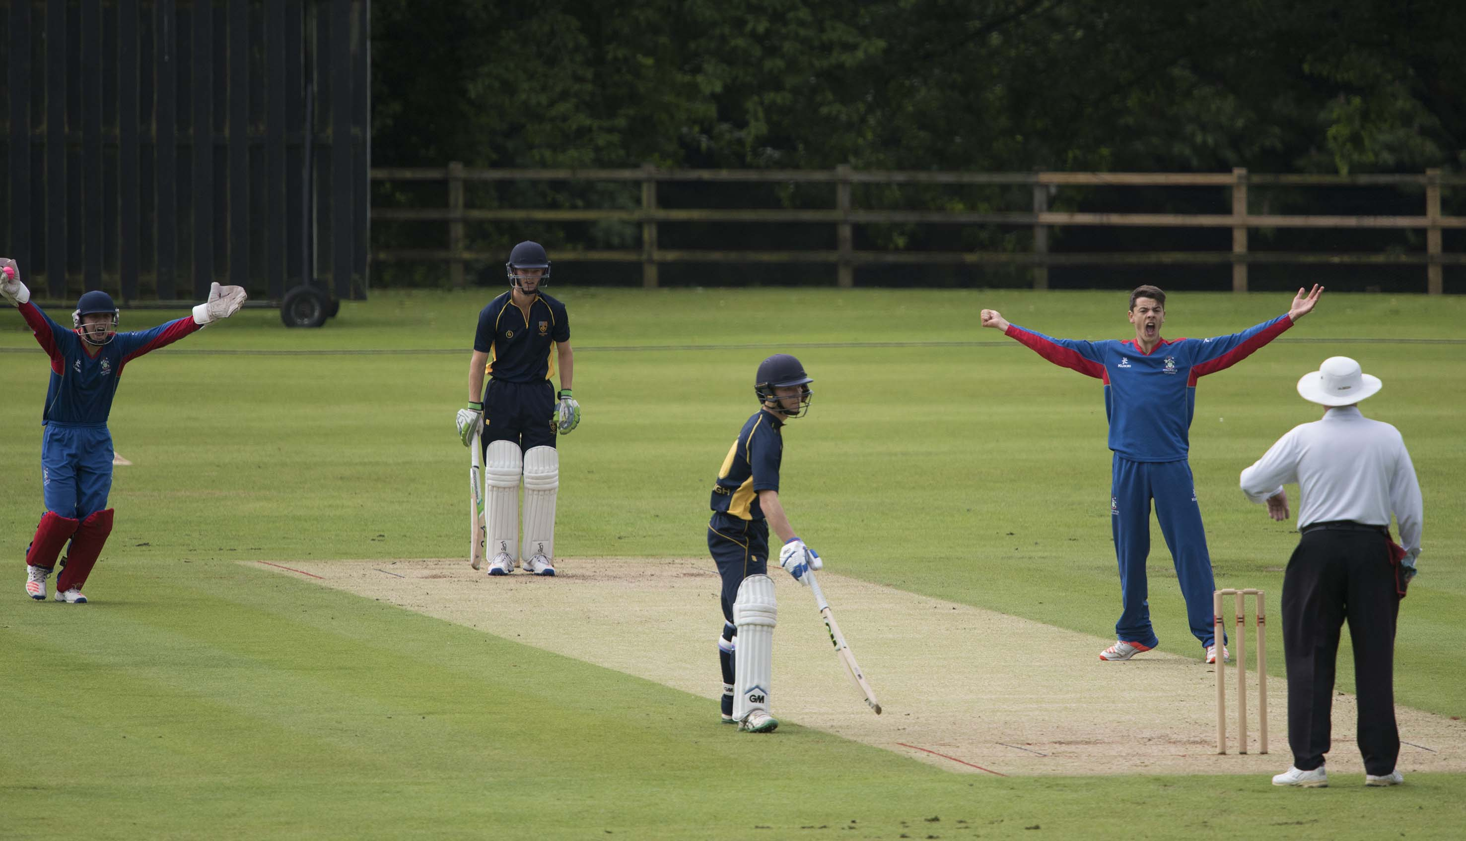
Austin ct Seward b Currie 5

Slide 5
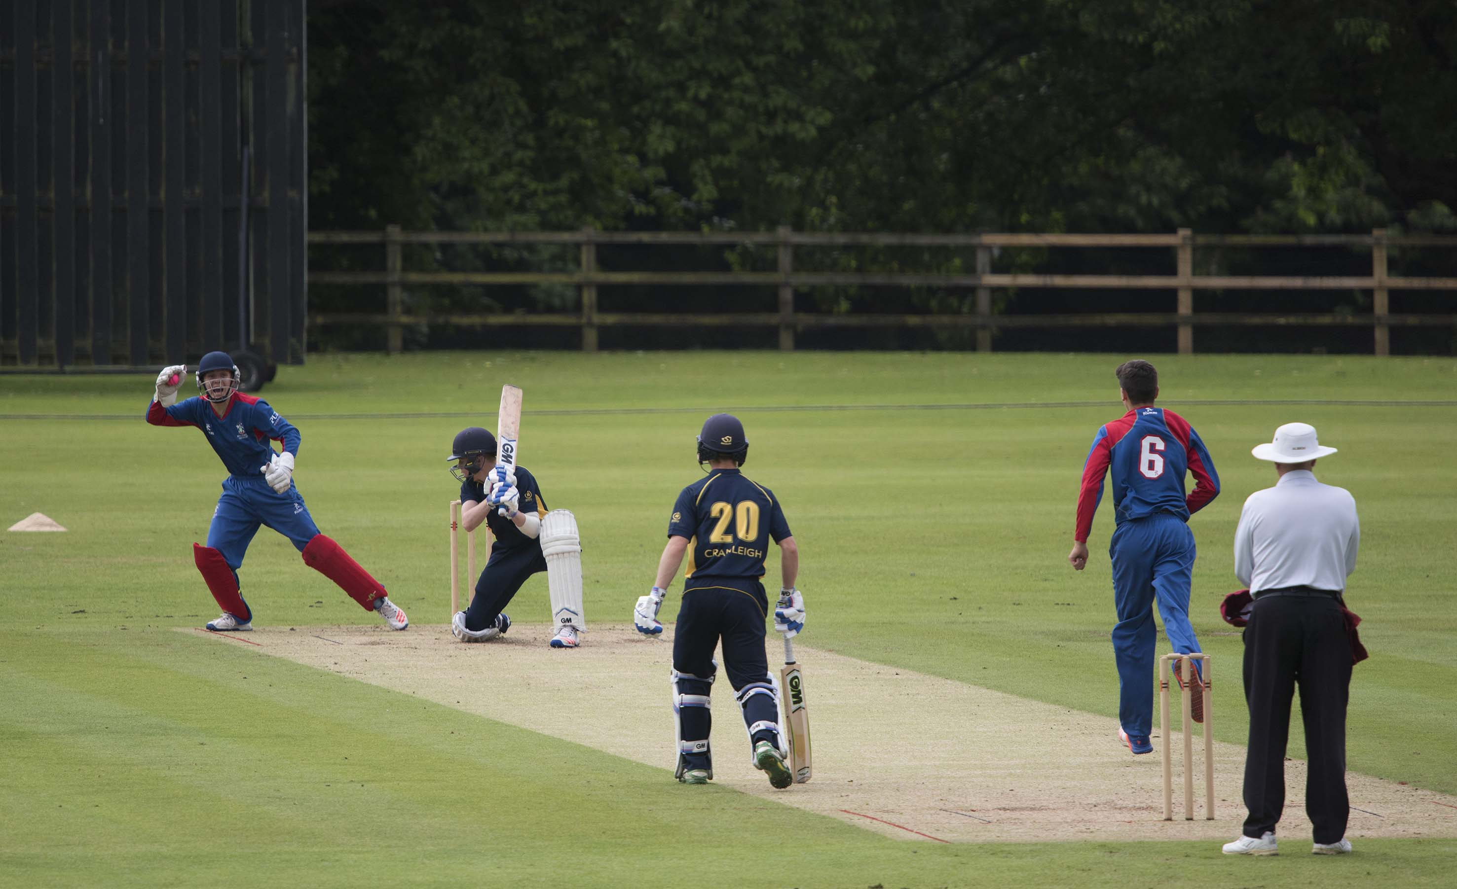
Pope ct Seward b Currie 0

Slide 6
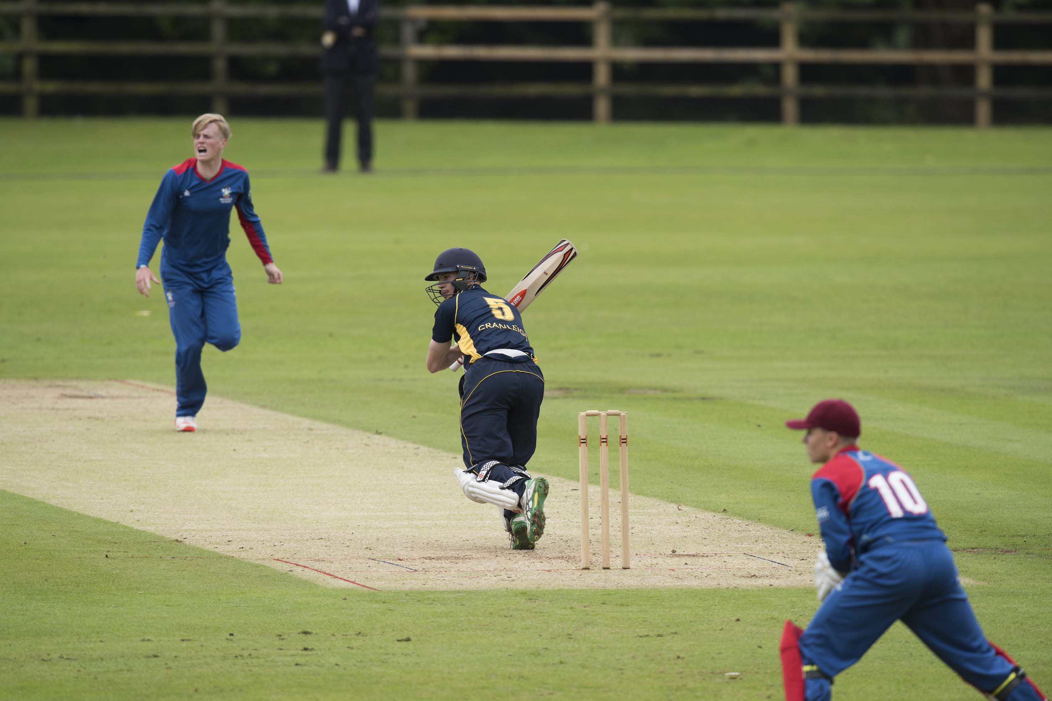
Angus Dahl batting during his 24

Slide 7
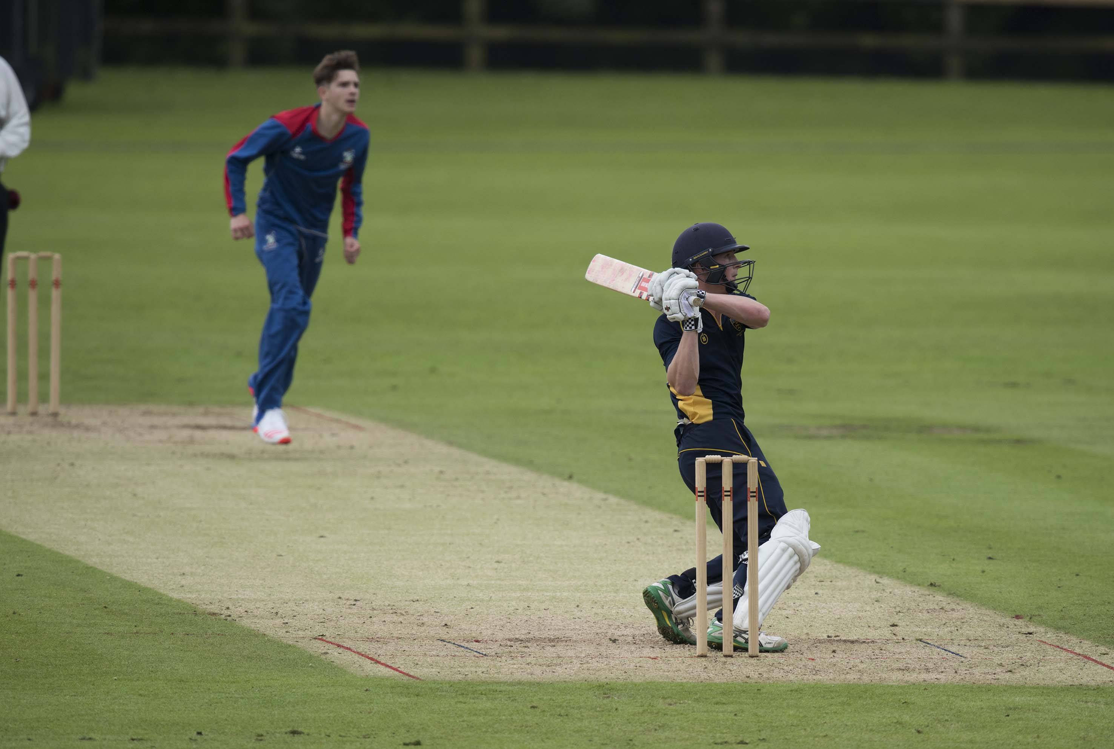
Dahl batting during his 24

Slide 8
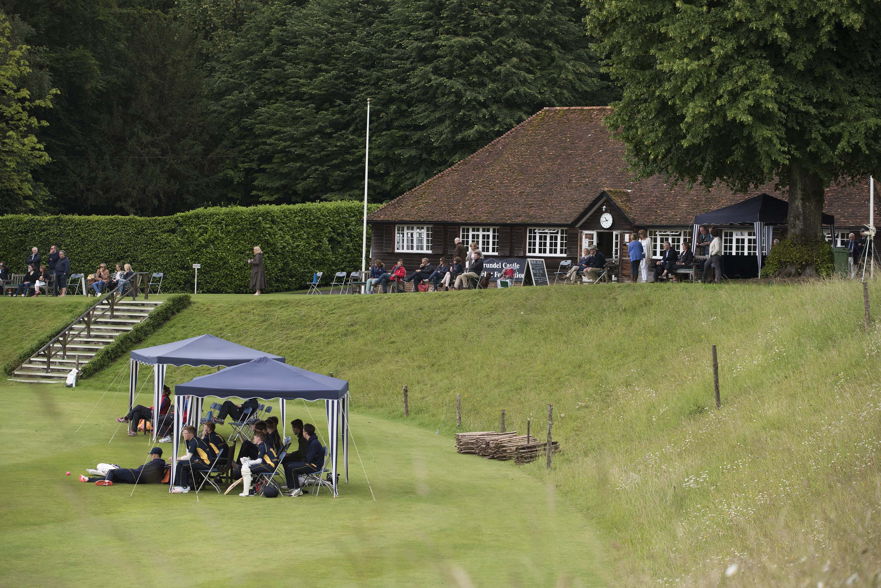
First semi-final Cranleigh v Millfield

Slide 9
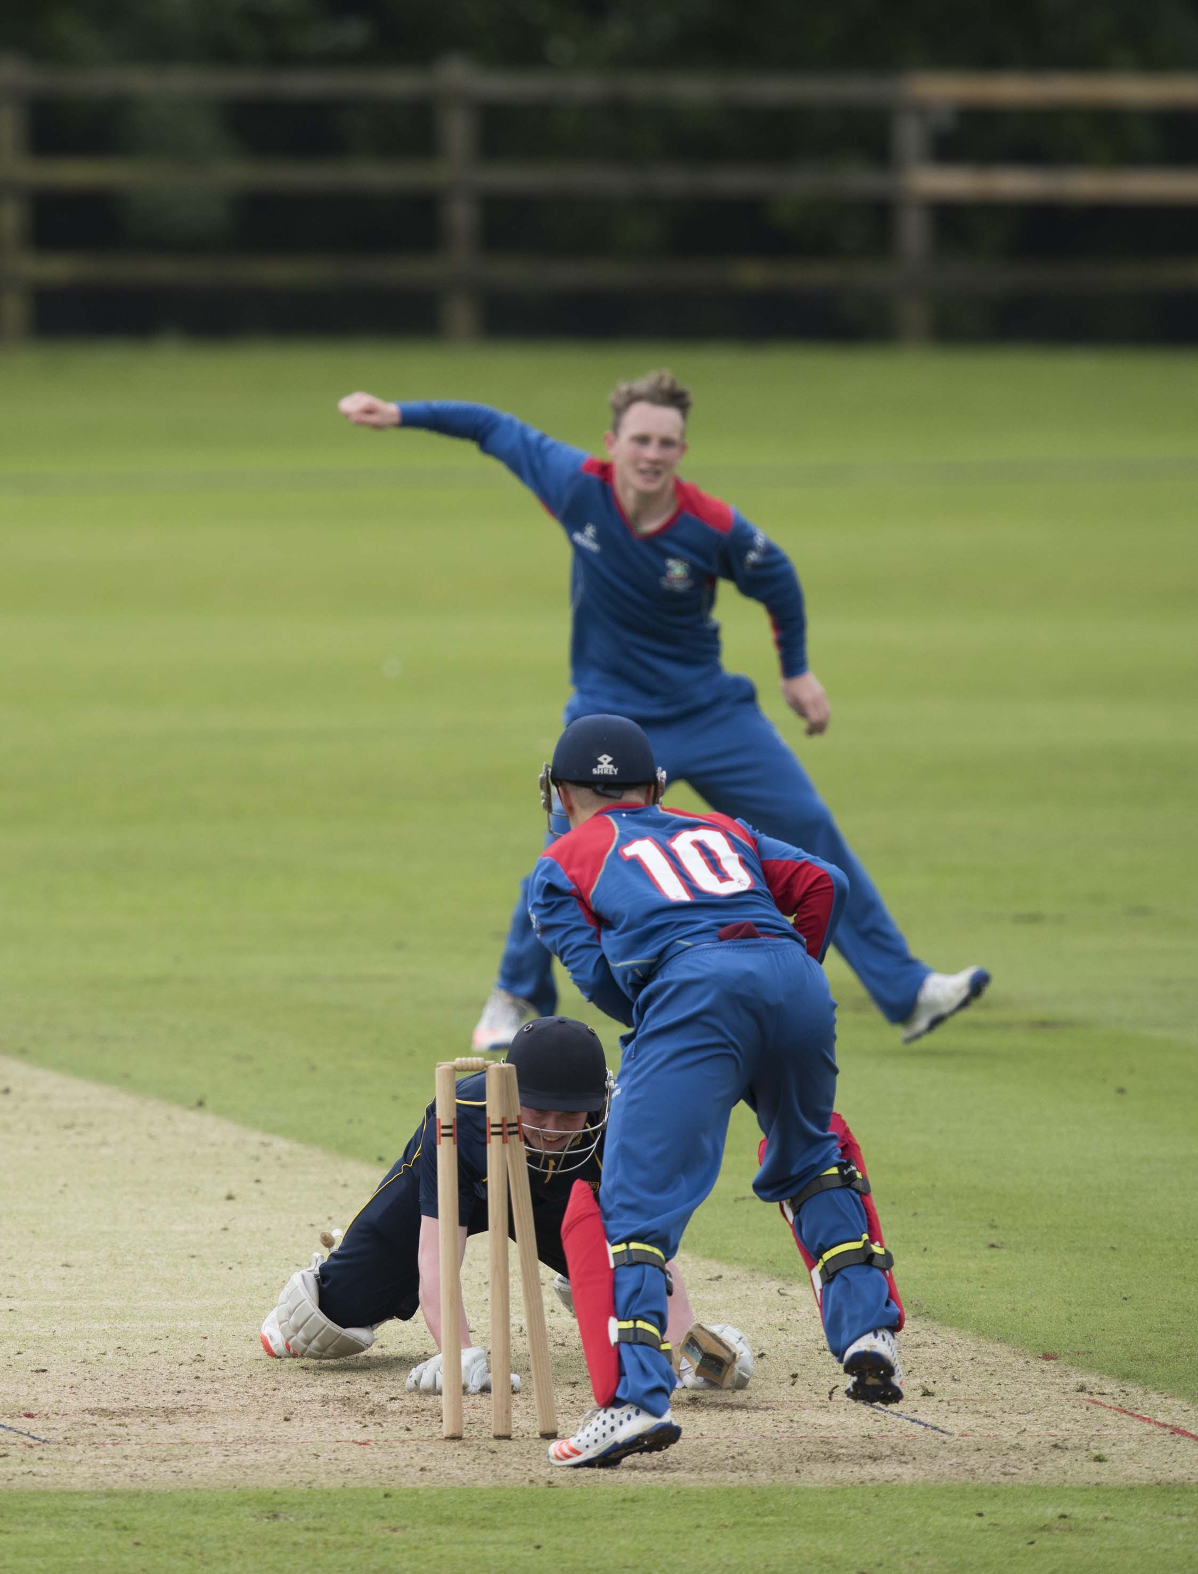
Tristem is stumped by Steward off Bevan

Slide 10
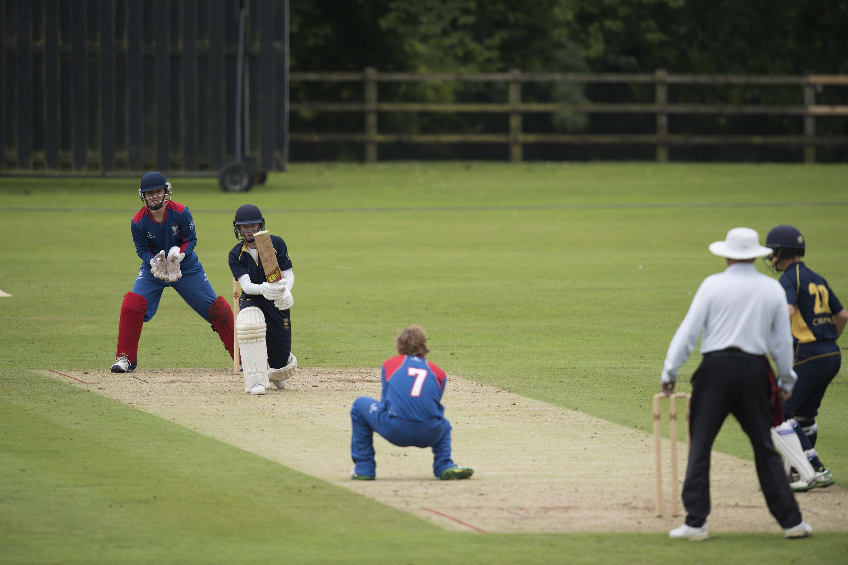
Trower (Cranleigh) c & b Clutterbuck

Slide 11
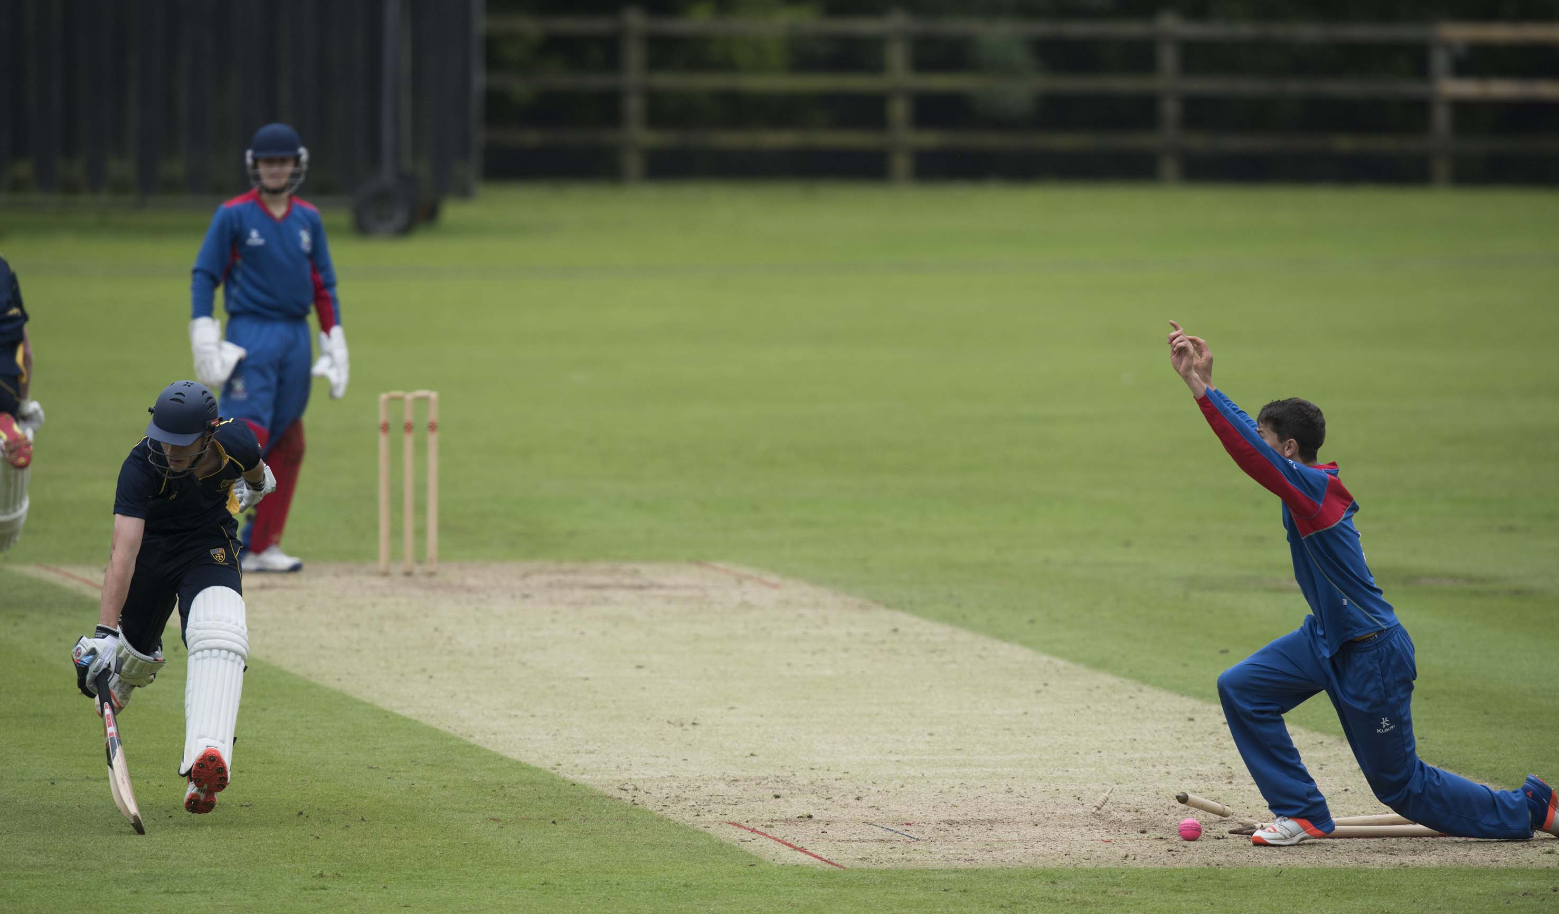
ARUNDEL - JULY 1: National Schools Twenty20 Finals Day 2016, first semi-final Cranleigh v Millfield, Cooper (Cranleigh) is run out by a throw from Lace,
11607715
photograph by Patrick Eagar

Slide 12
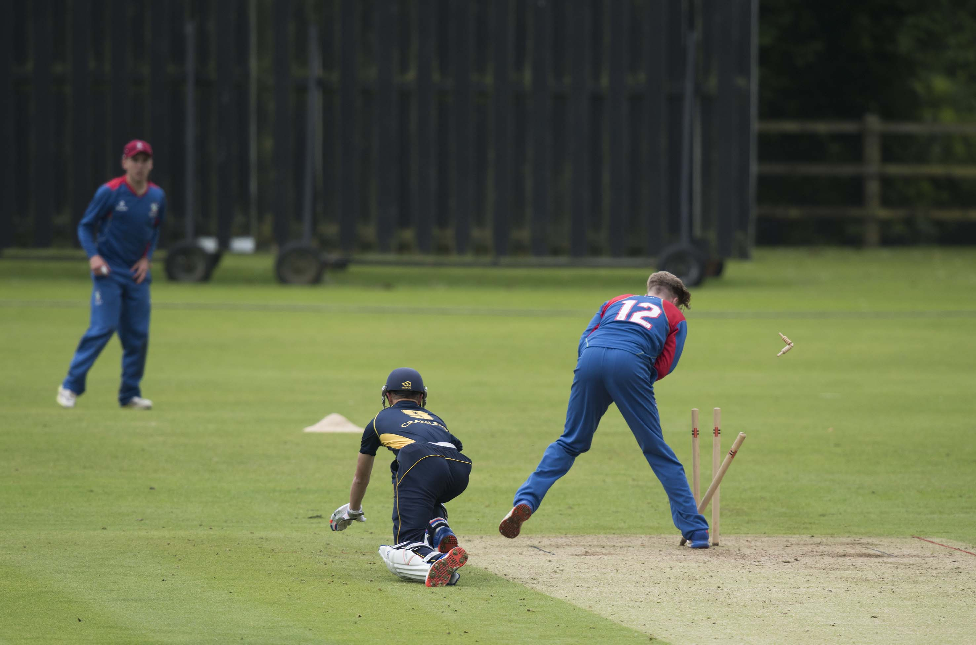
Charlie Terry (Cranleigh) is run out in the final over as McCoy removes the bails after a throw from Lace

Slide 13
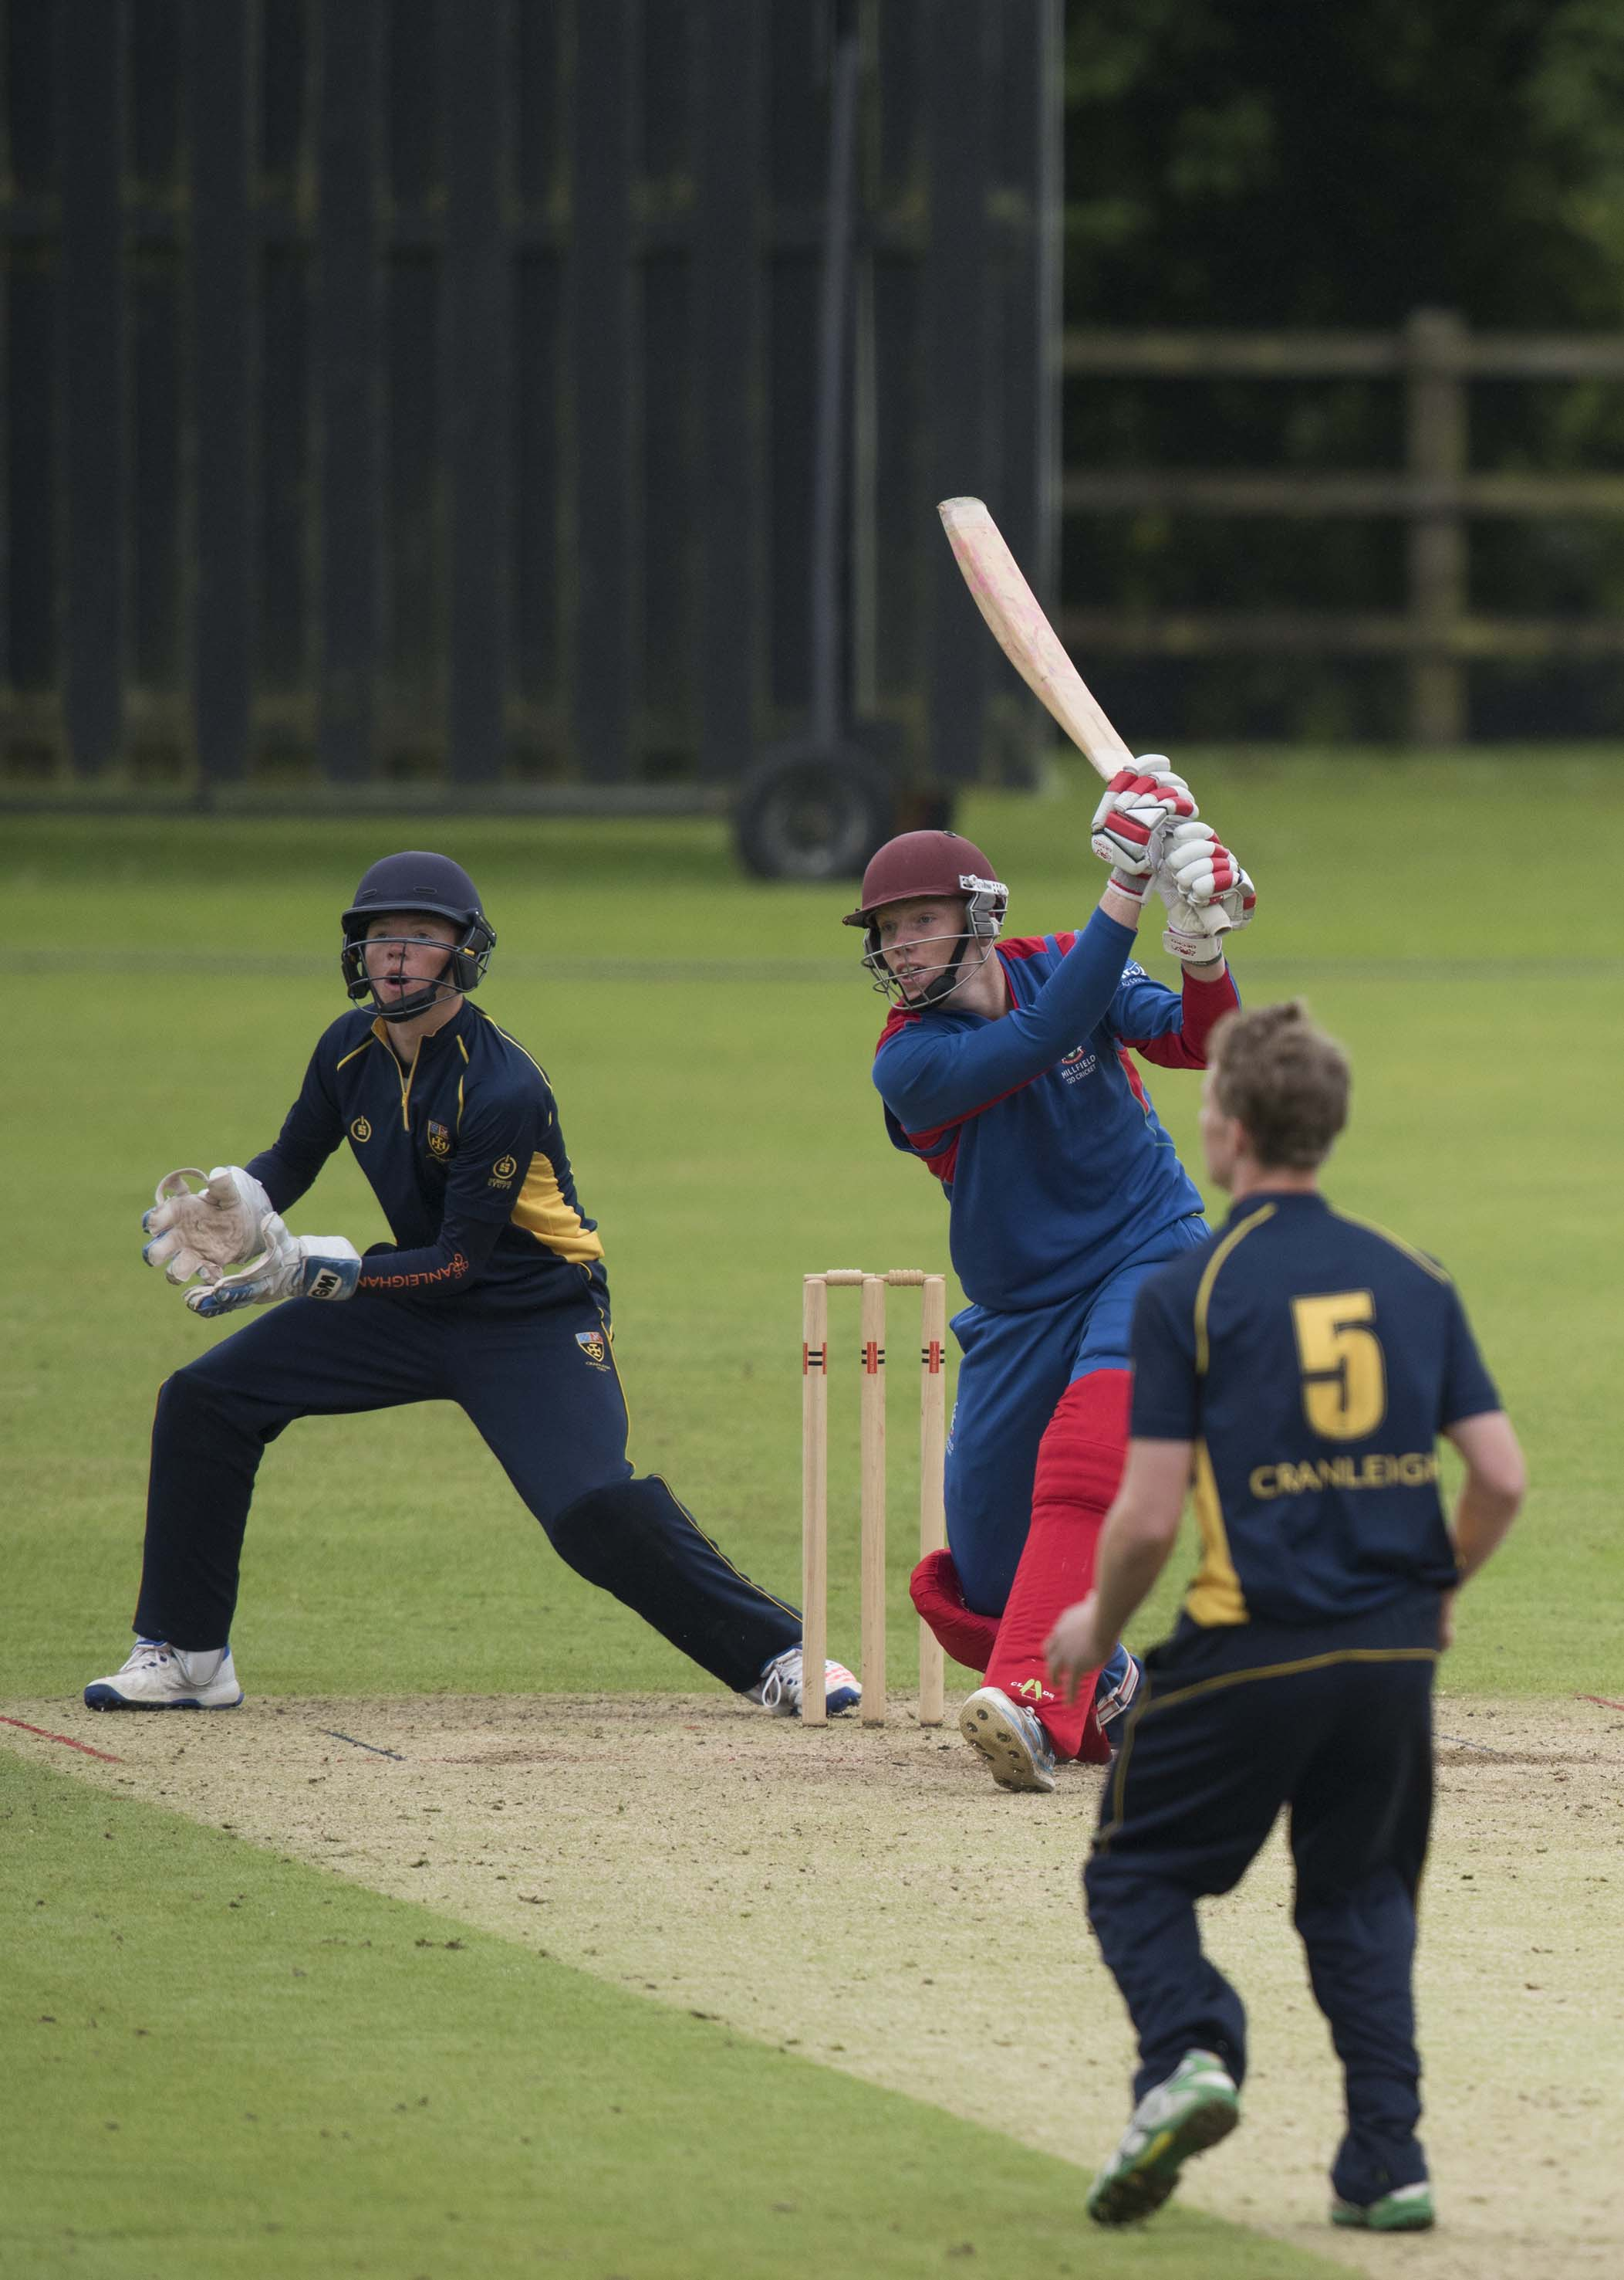
Finlay Trenouth (Millfield) drives Angus Dahl during his 13

Slide 14
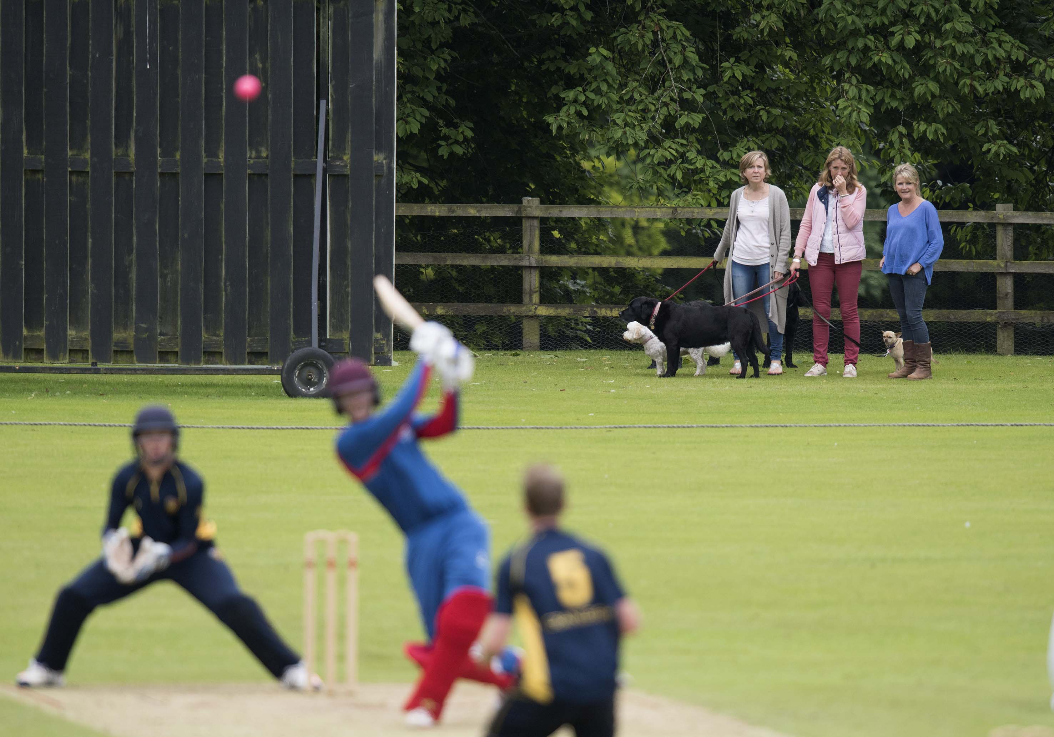
Taking the dogs for a walk.

Slide 15
The second semi-final
Felsted in dark blue
Sedbergh in brown

Slide 16
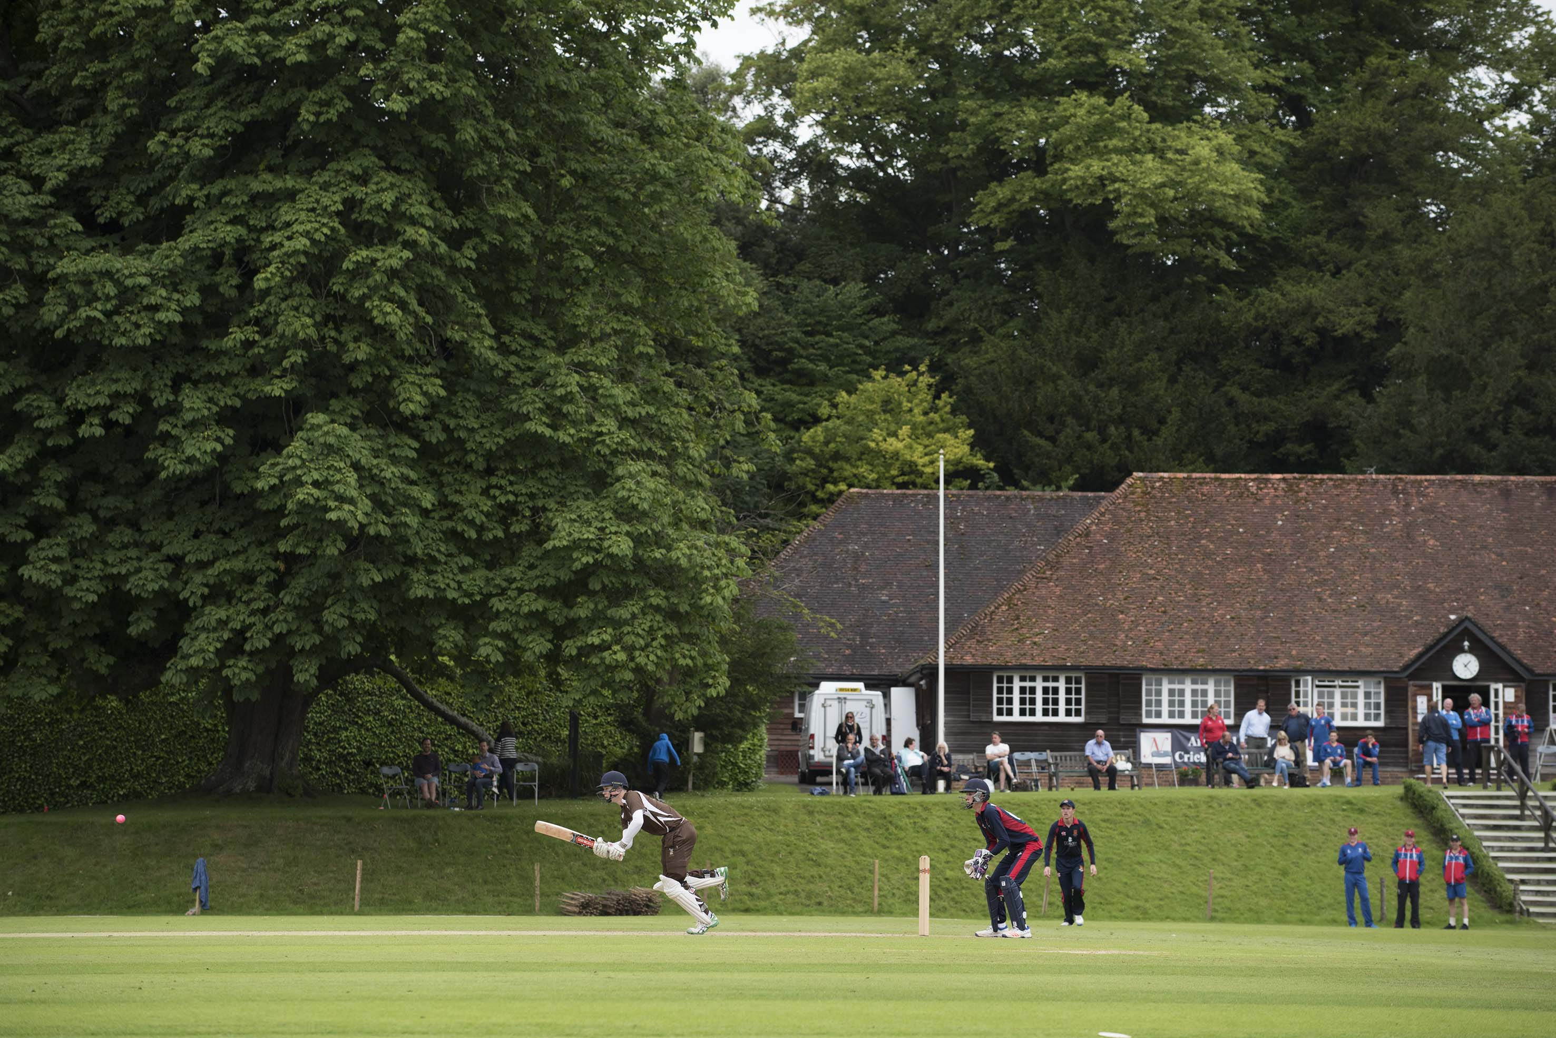
Marcus Stables (Sedbergh) batting during his 12

Slide 17
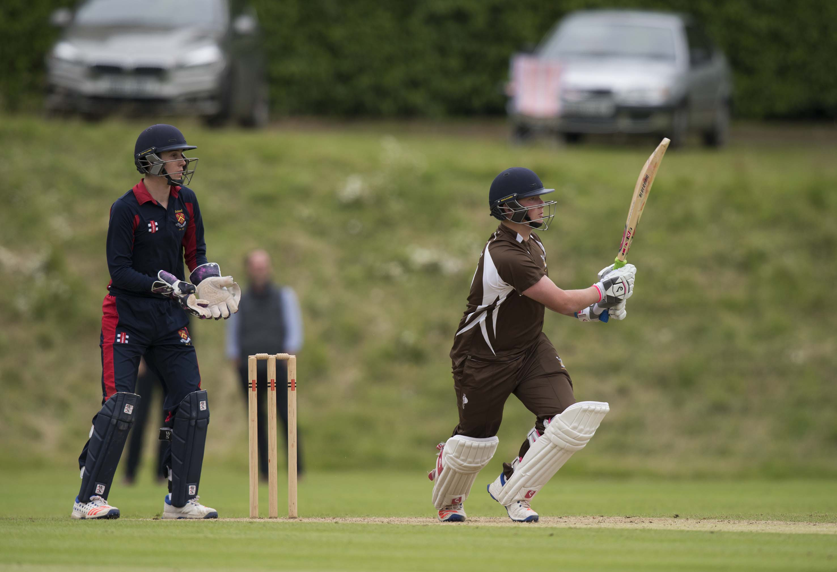
Chris Sanders (Sedbergh) batting during his 12; James Seward is the wicketkeeper

Slide 18
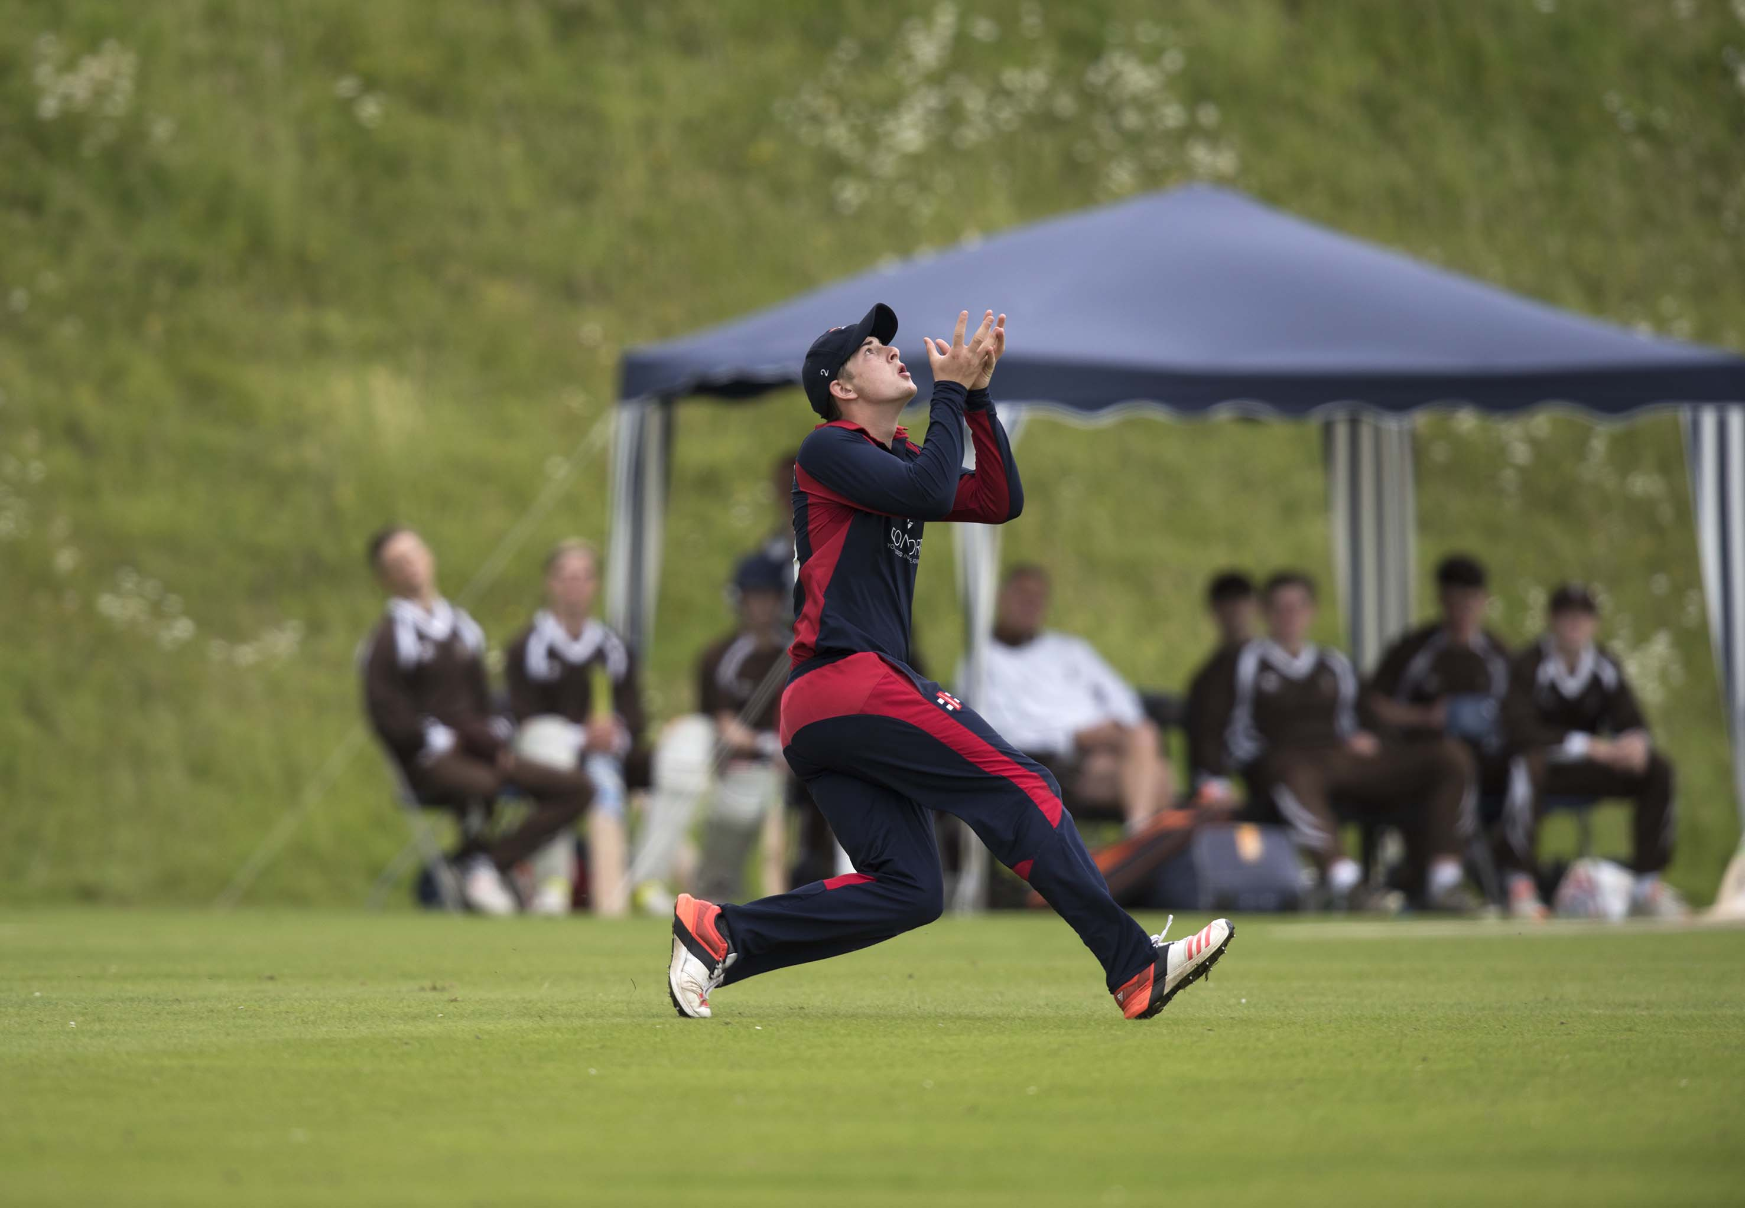
Luke Chapman (Millfield) catches James Park-Johnson off Ashleigh Cox for 17

Slide 19
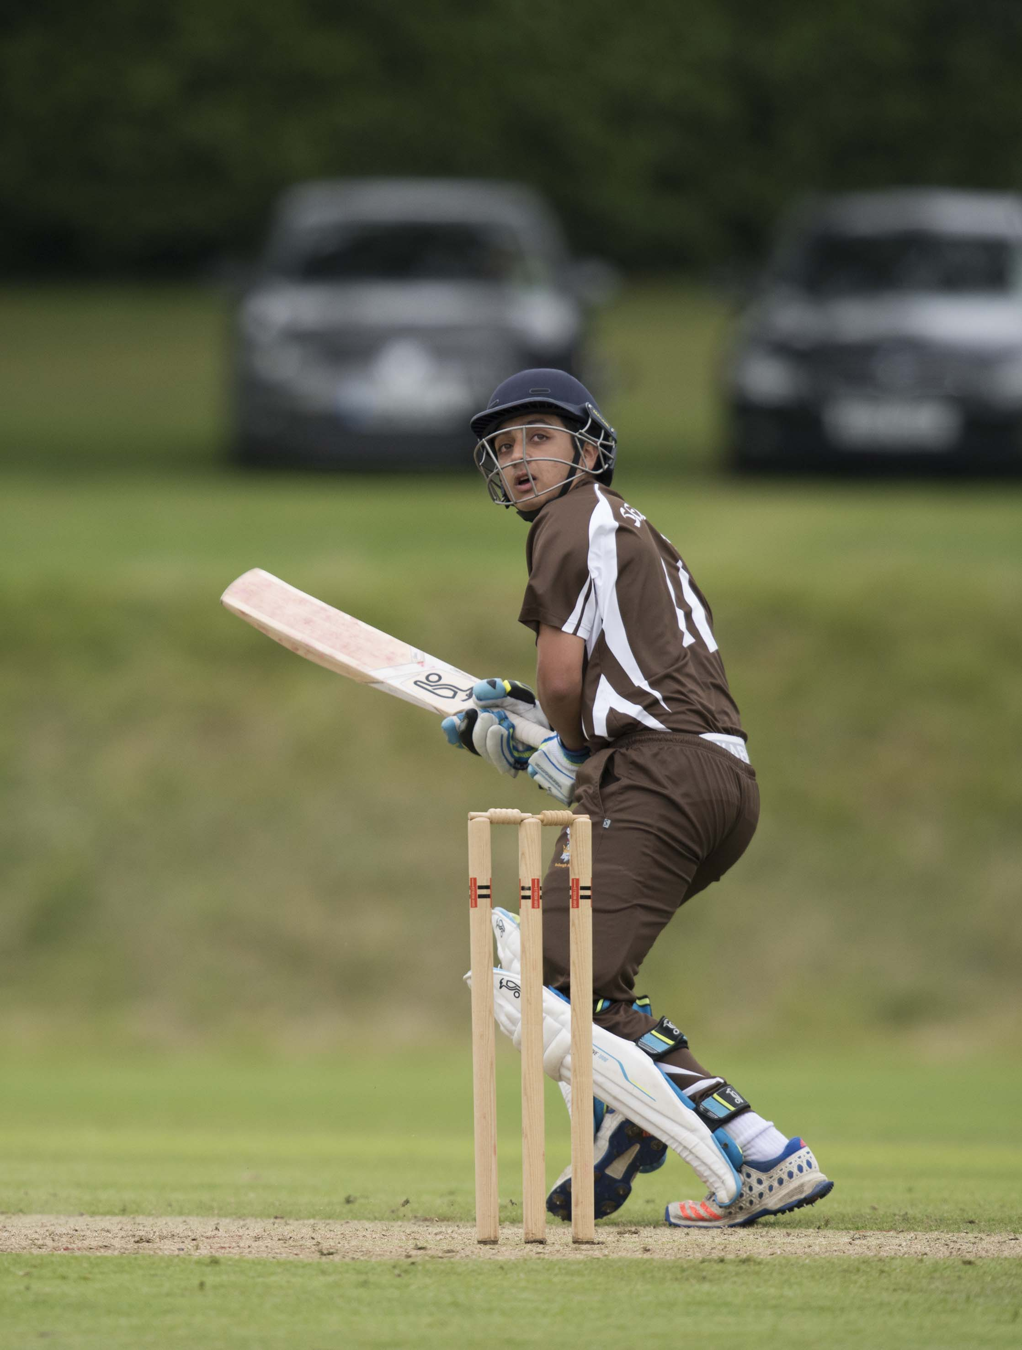
Kyme Tahirkheli (Sedbergh) hits a four

Slide 20
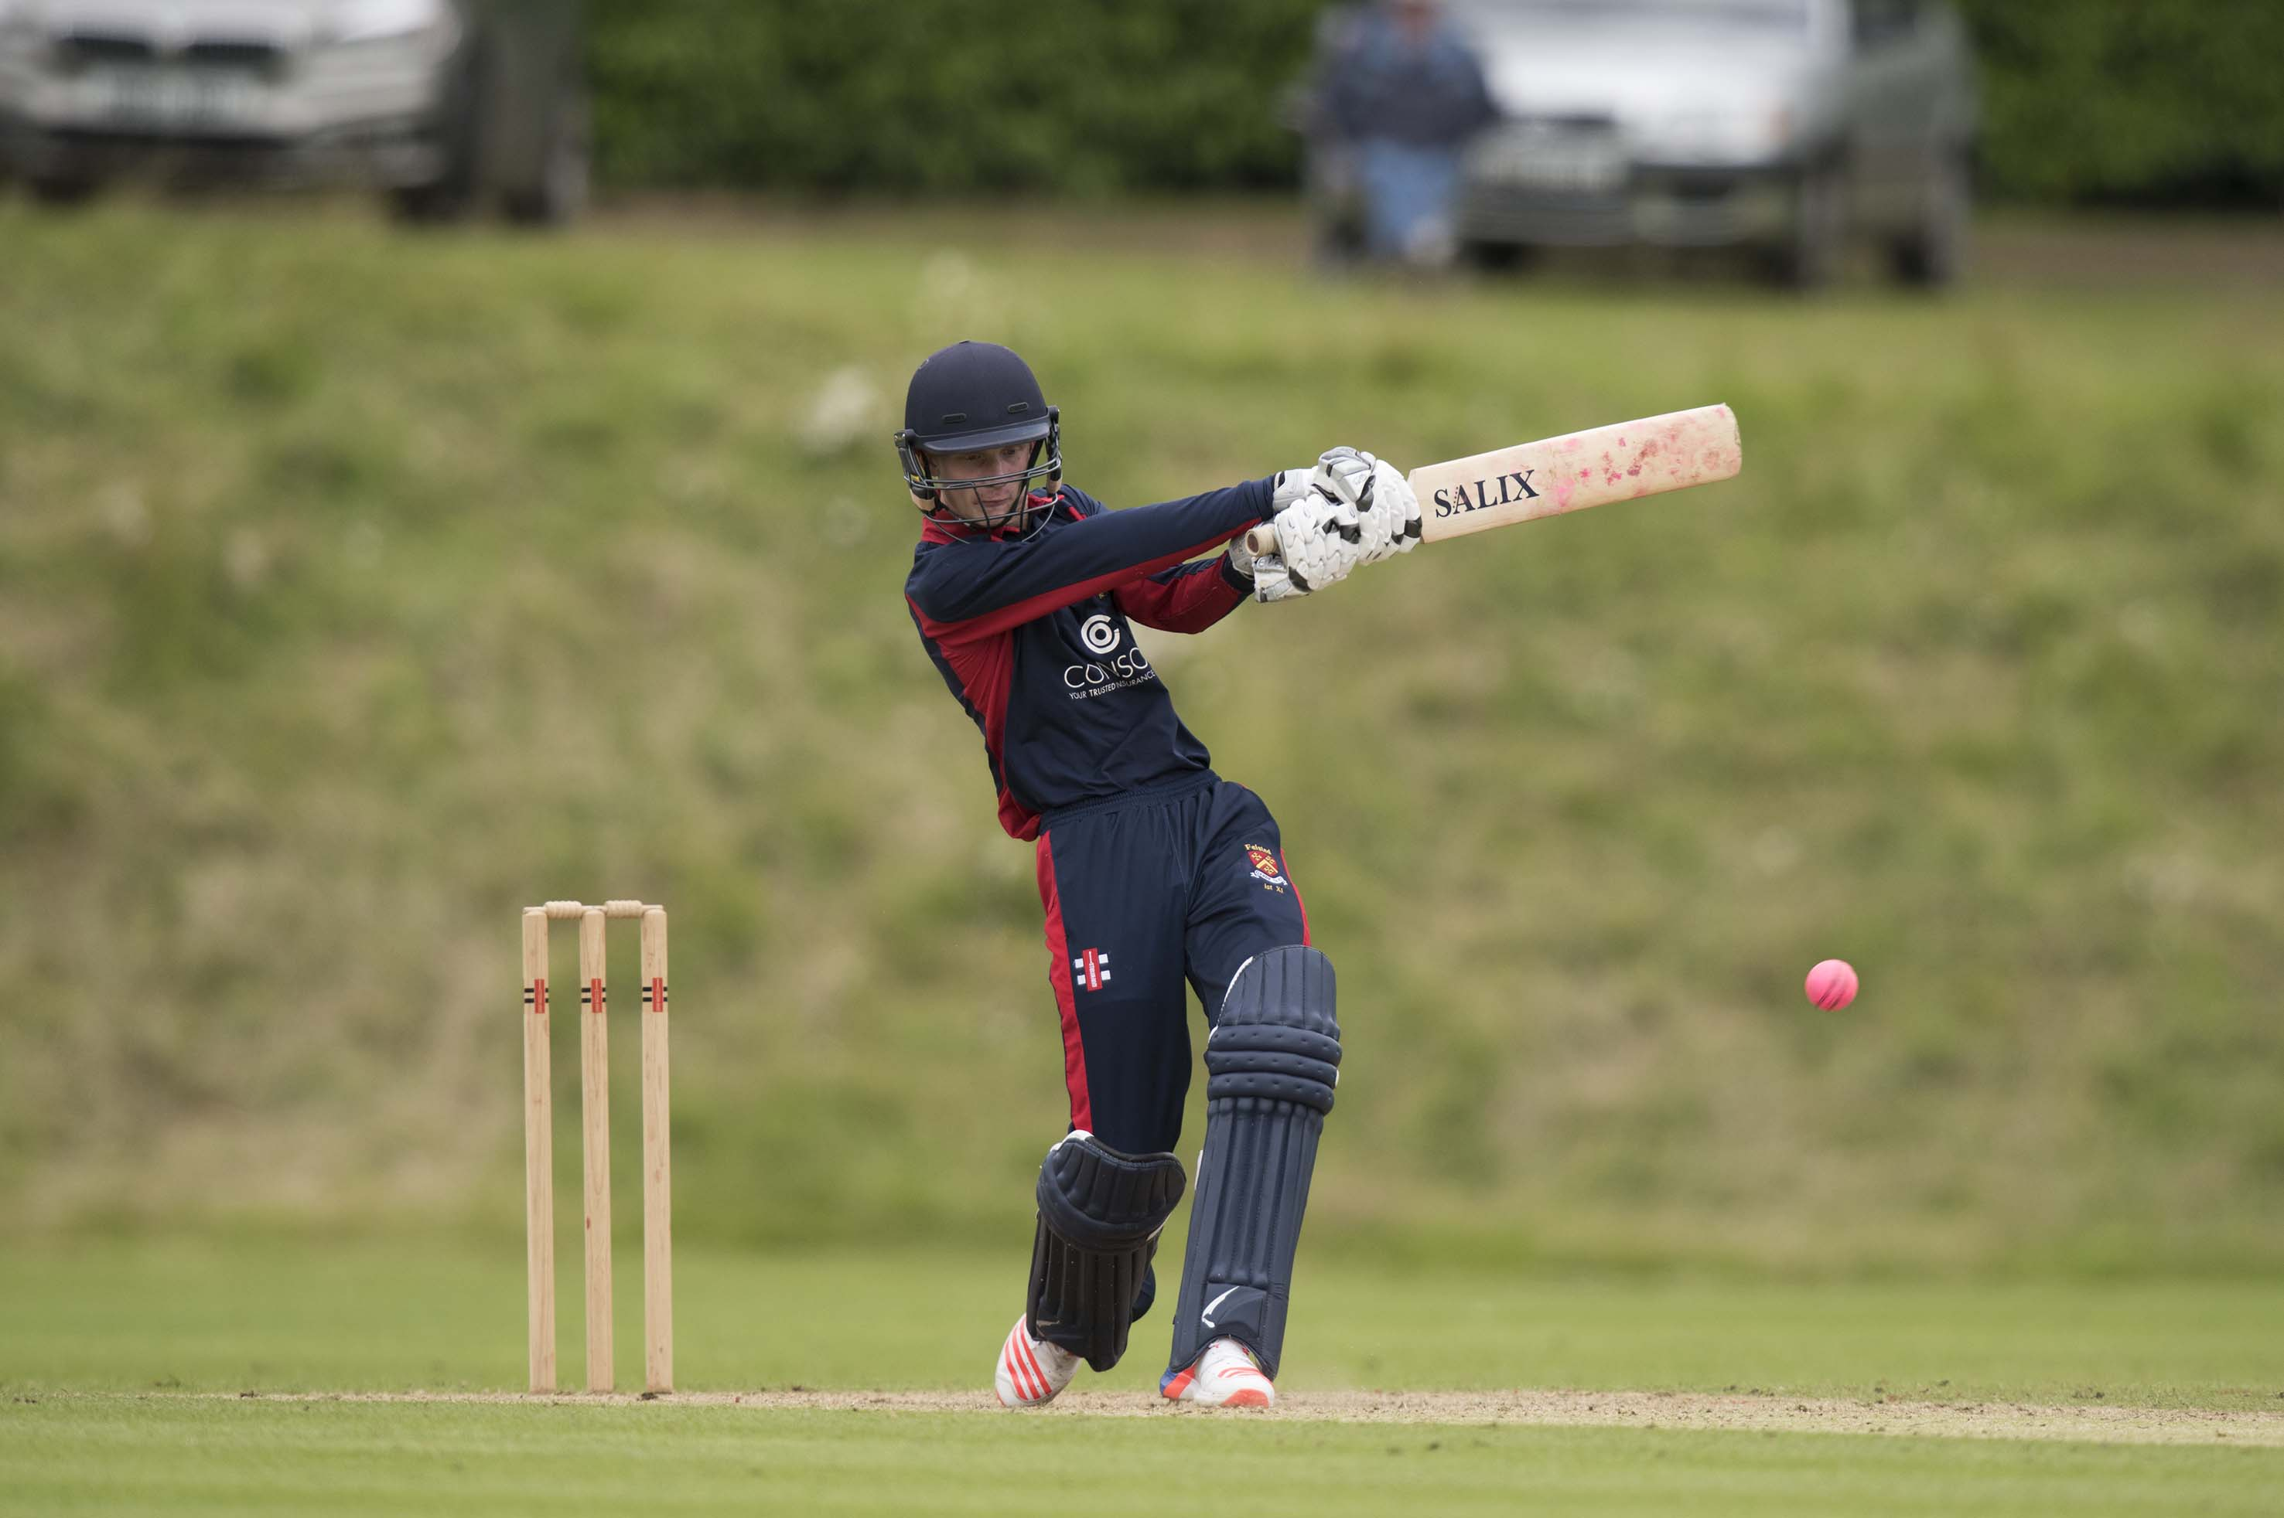
Jordan Cox (Felsted) batting during his 44

Slide 21
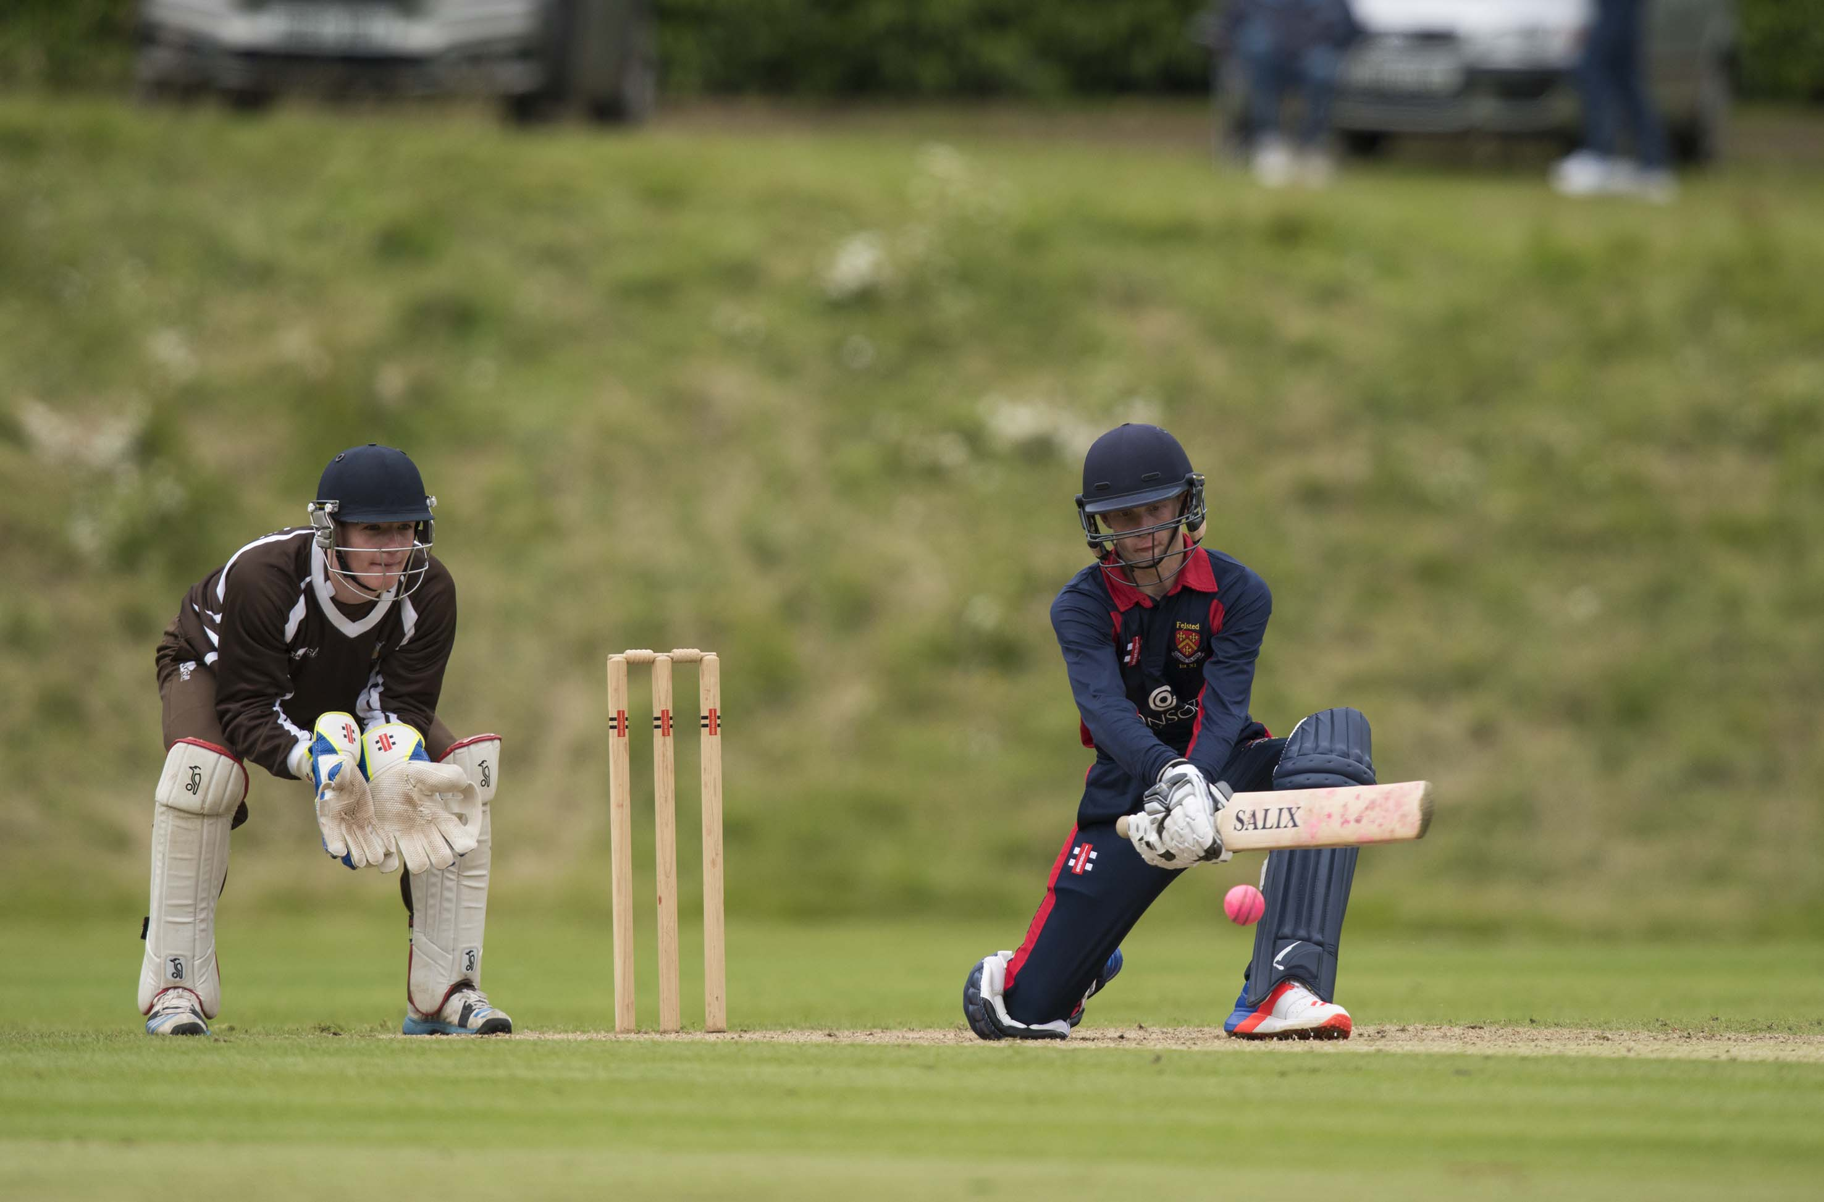
Jordan Cox (Felsted) reverse sweeps on his way to 44; Max Silvester is the wicketkeeper.

Slide 22
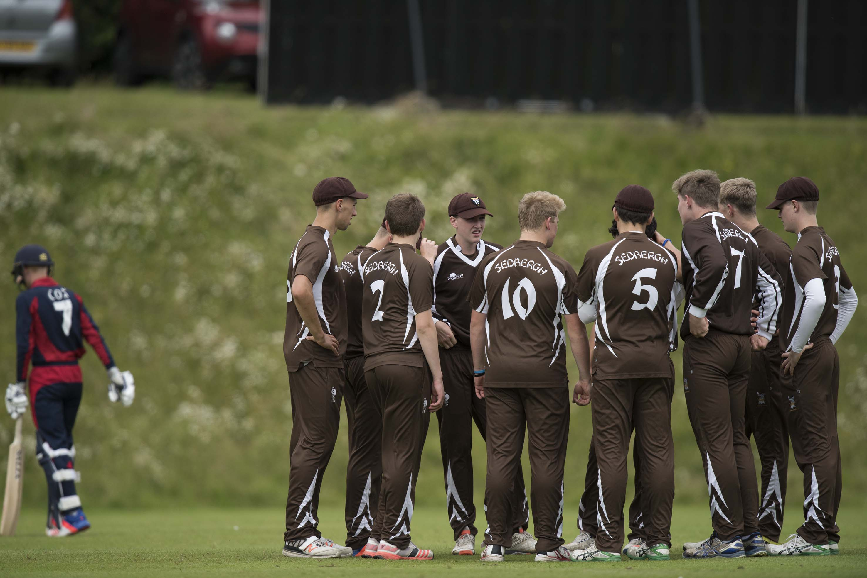
The Sedbergh team are pleased to dismiss Jordan Cox for 44, caught by Park-Johnson off Barrett

Slide 23
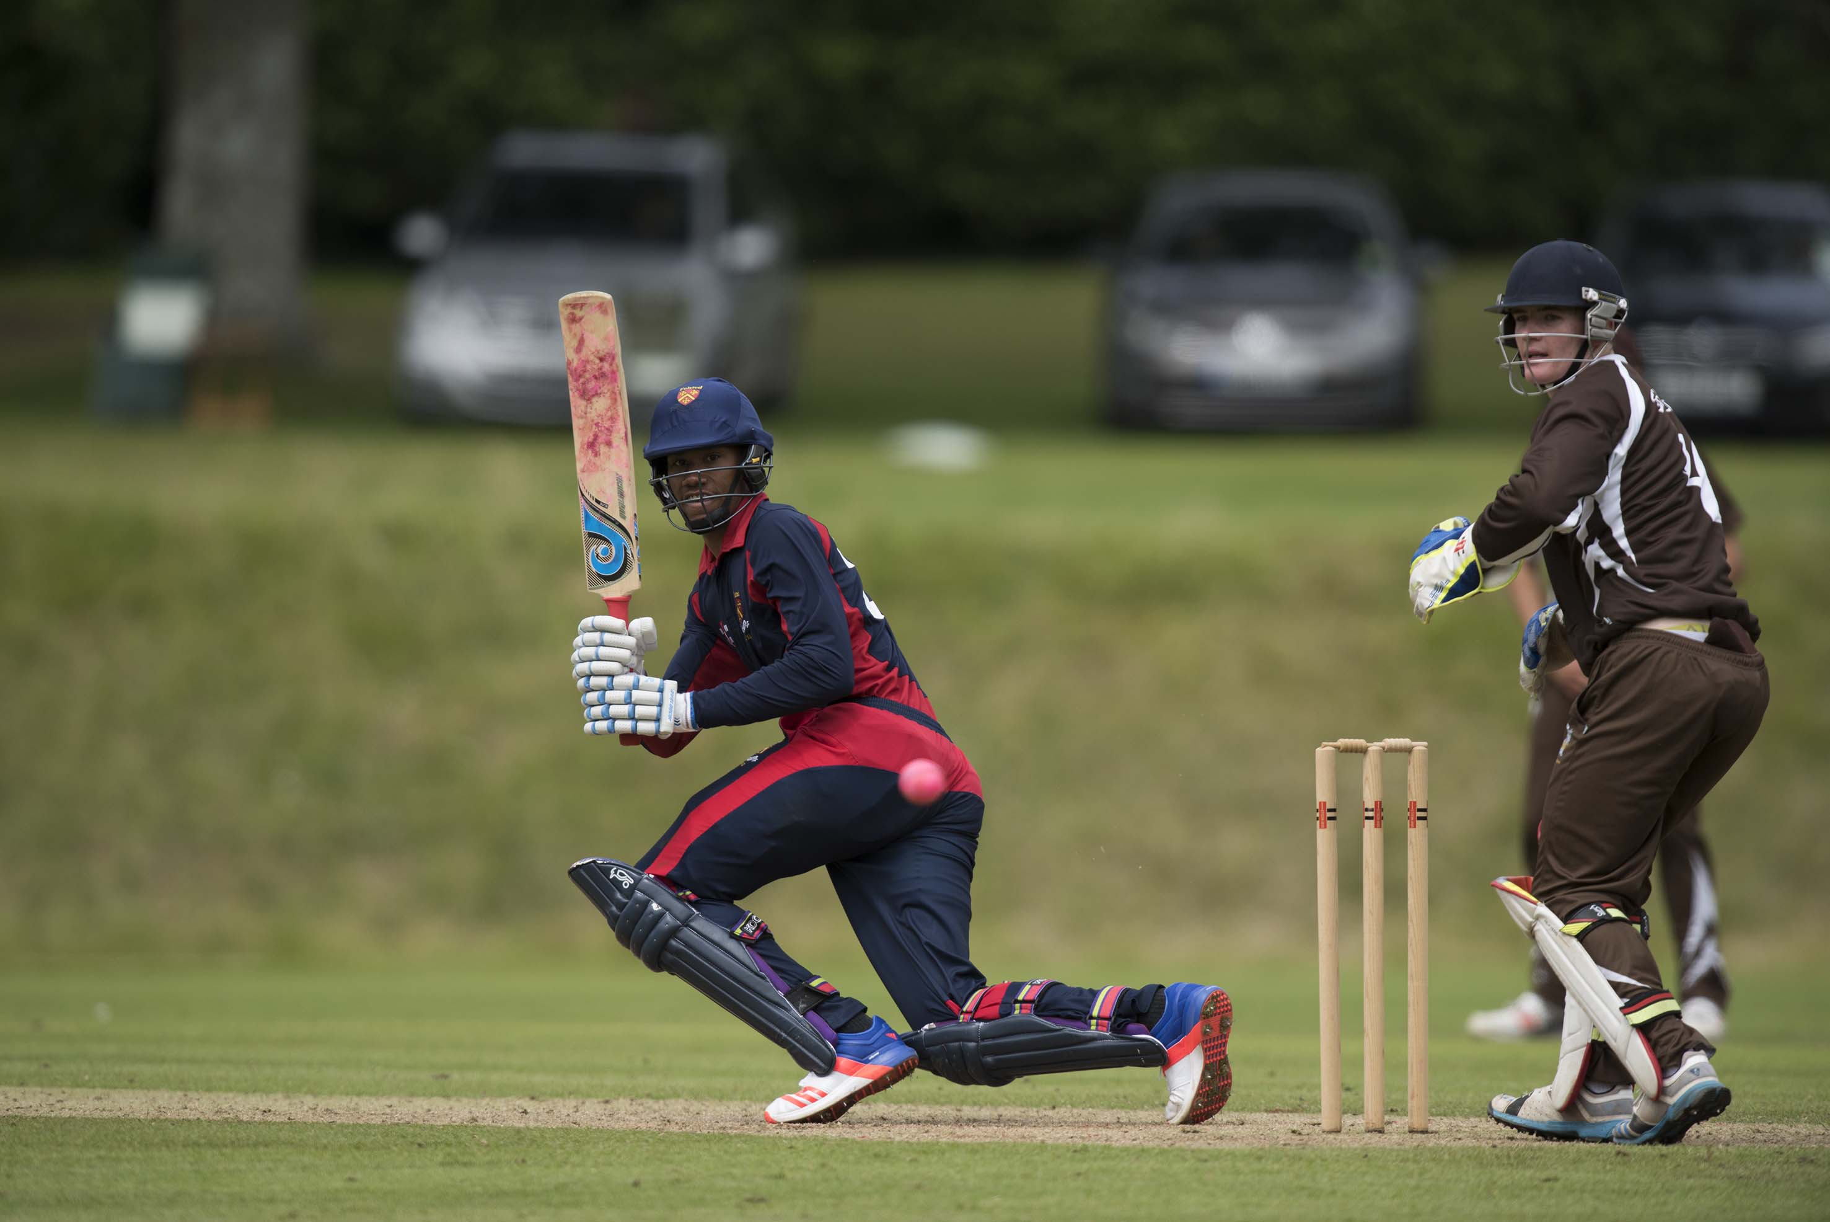
Yvan Grant, the Felsted captain, made 29 not out

Slide 24
The final
Millfield in light blue
Felsted in dark blue

Slide 25
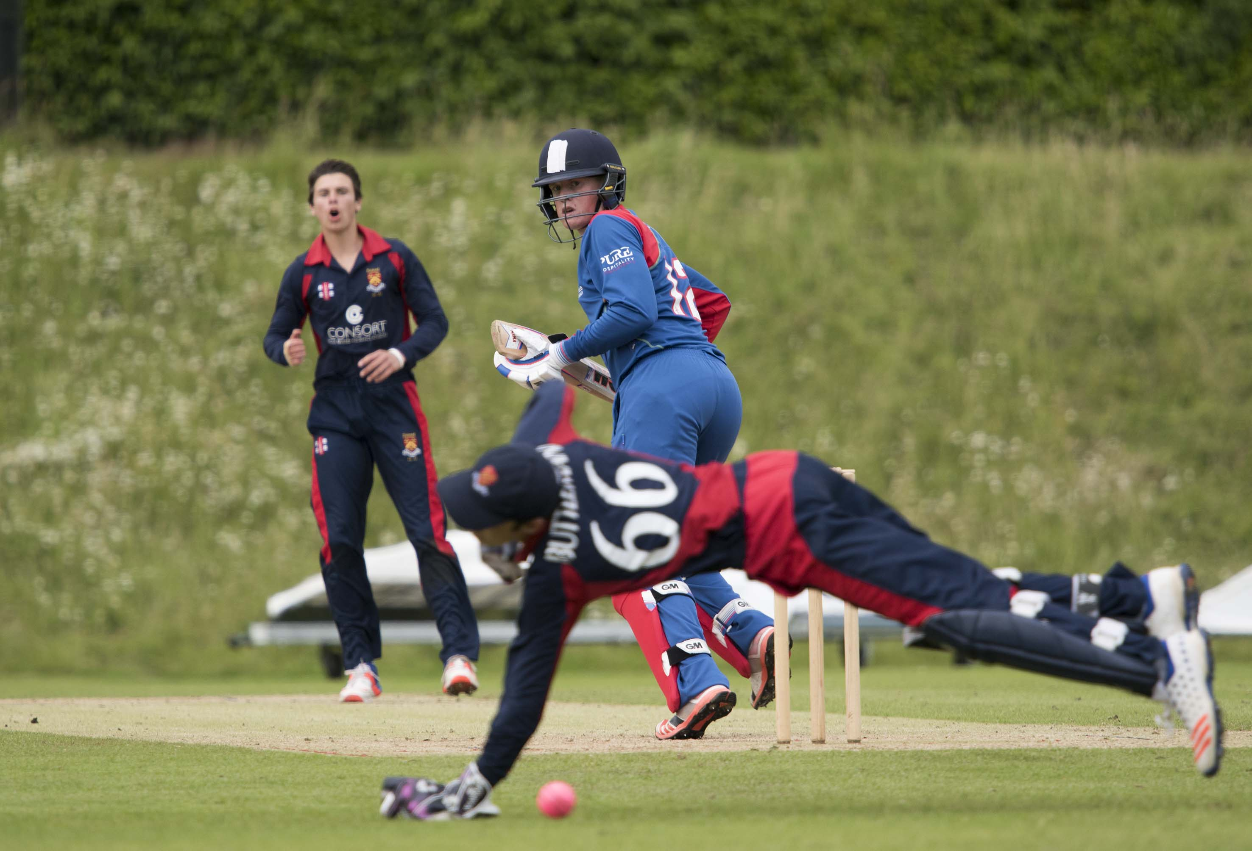
Joshua McCoy (Millfield) edges past wicketkeeper William Buttleman for 4

Slide 26
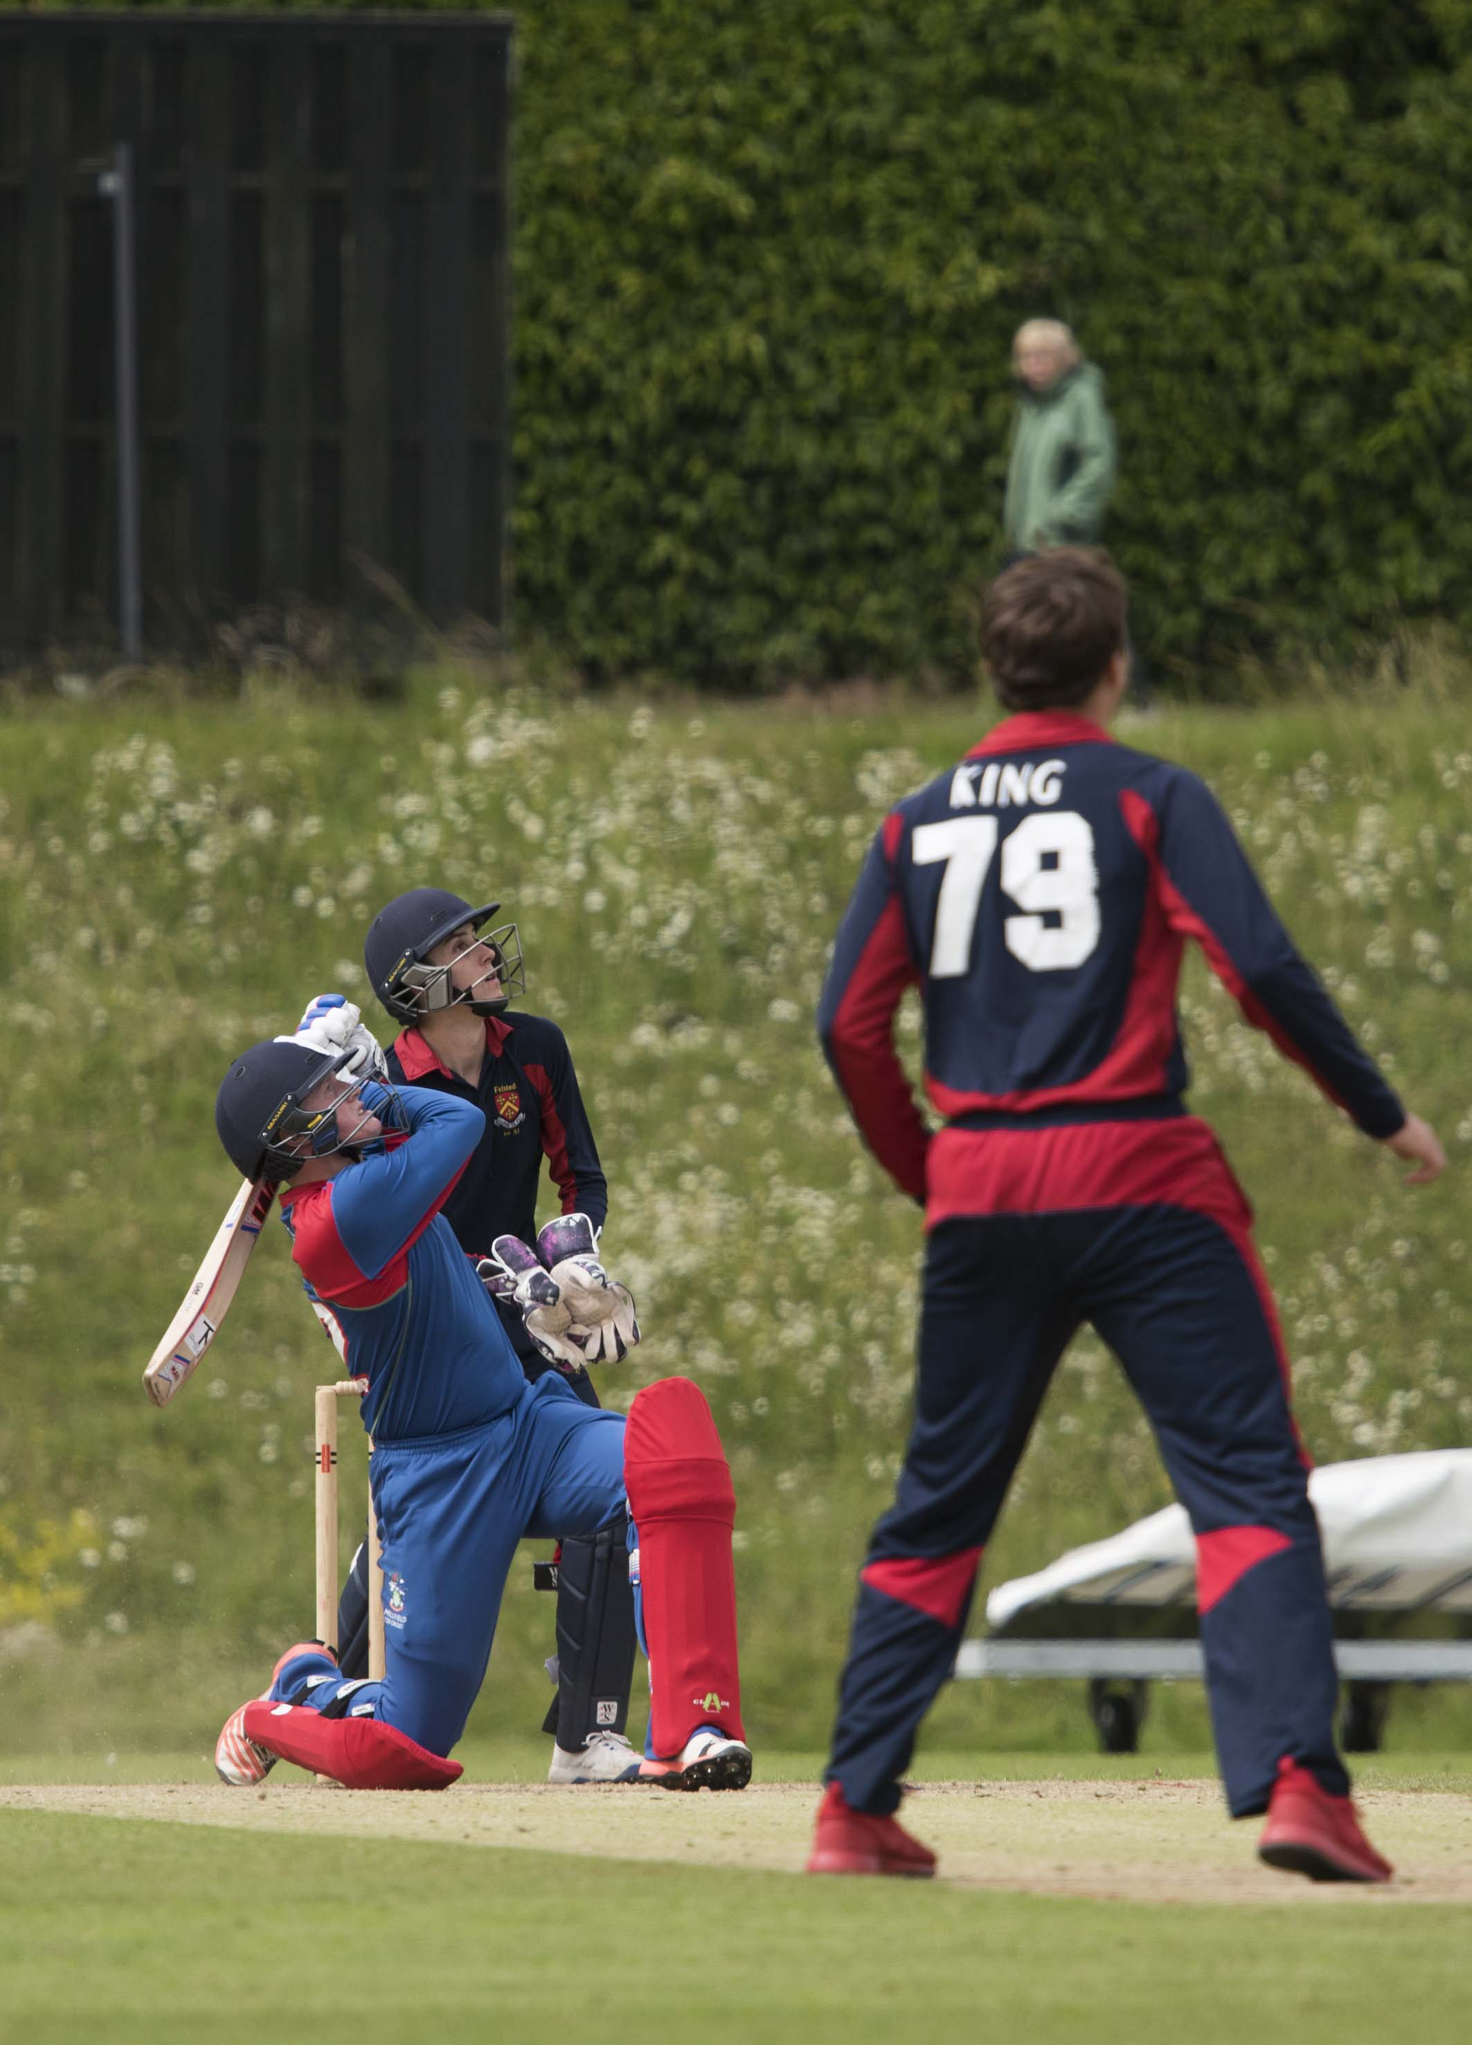
Joshua McCoy (Millfield) hits Joshua King for 6 during his 93

Slide 27
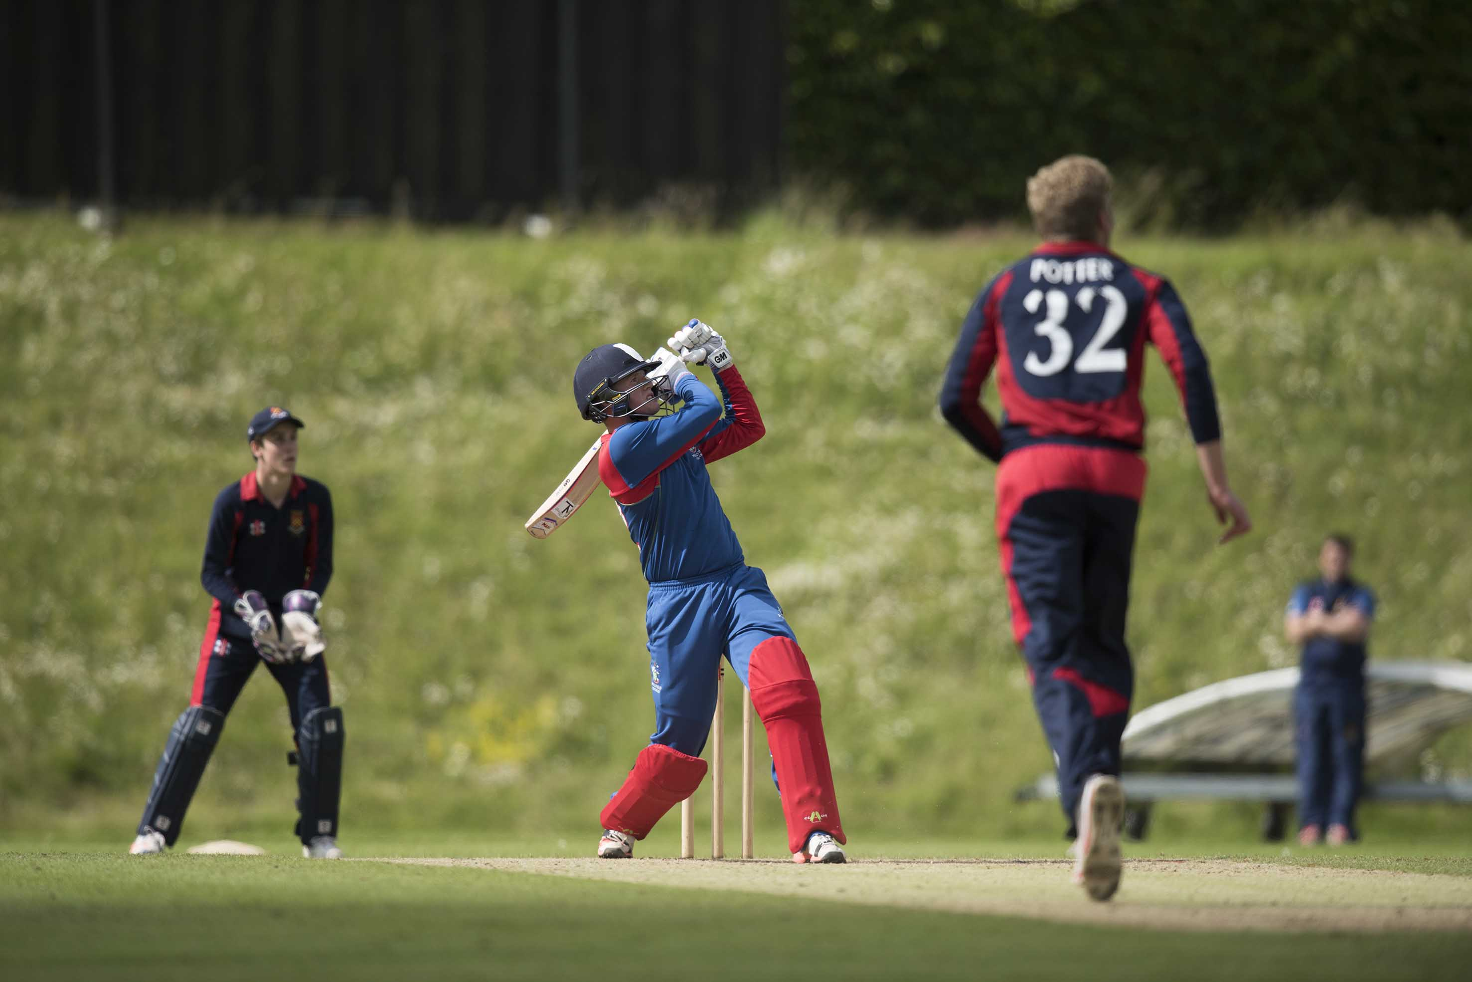
J McCoy of Millfield, who scored 93, hits E Potter for 6

Slide 28
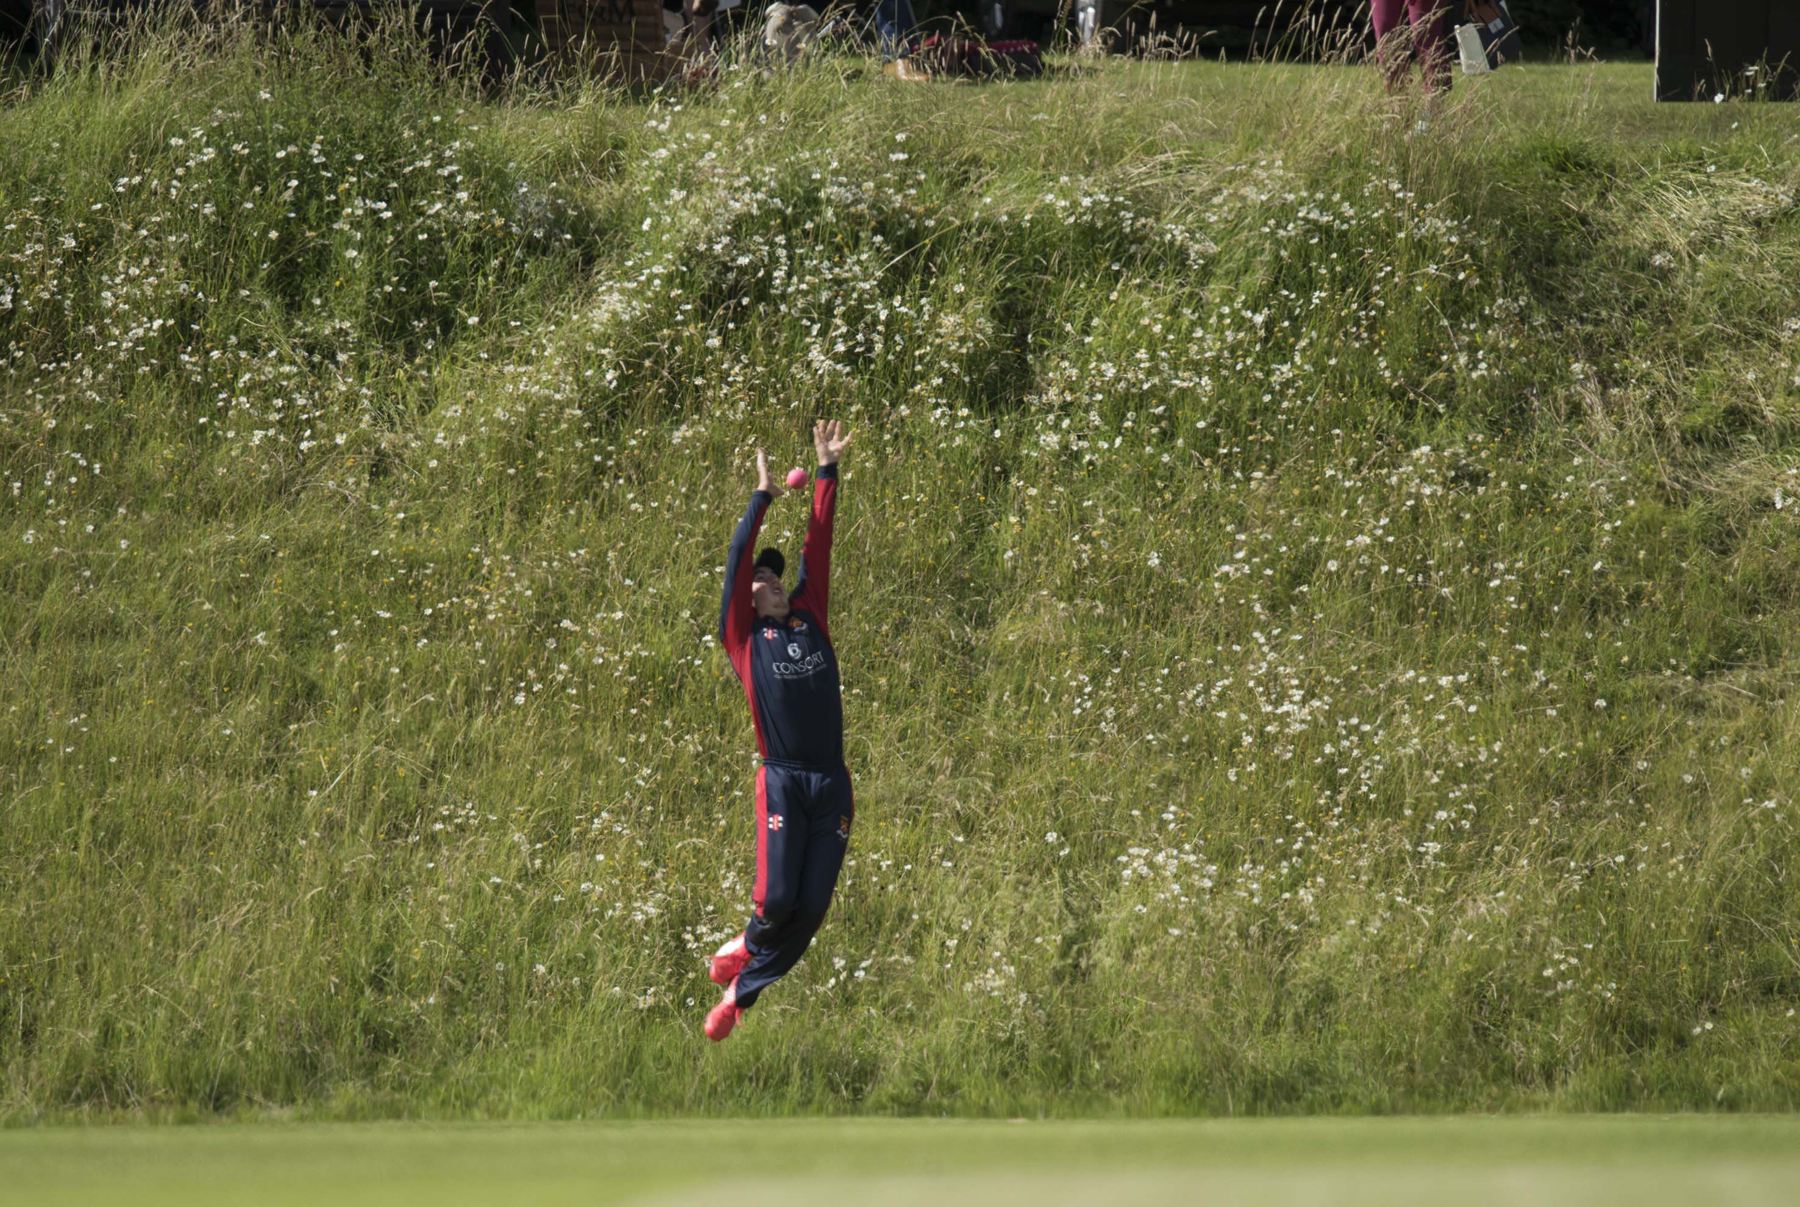
Benjamin Waring of Felsted leaps in vain while Joshua McCoy hits another six

Slide 29
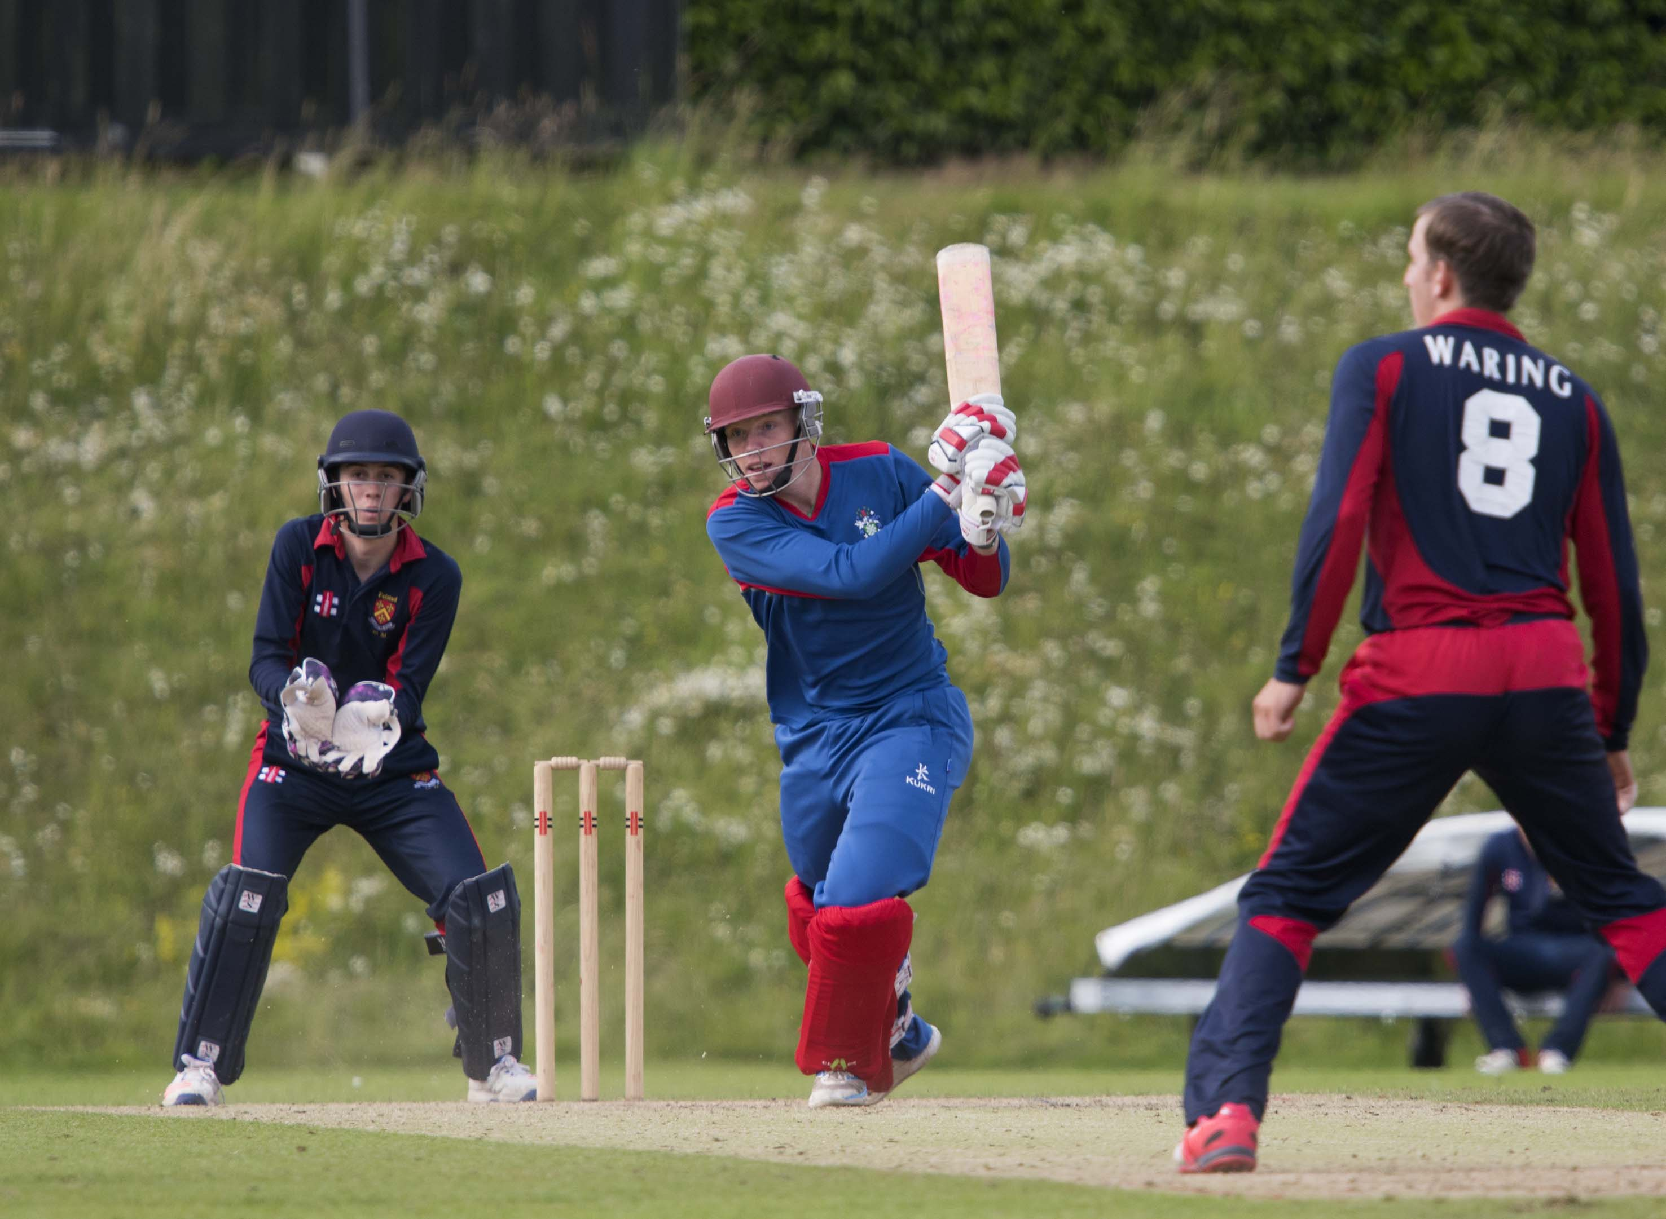
Finlay Trenouth (Millfield) drives Ben Waring during his 24

Slide 30
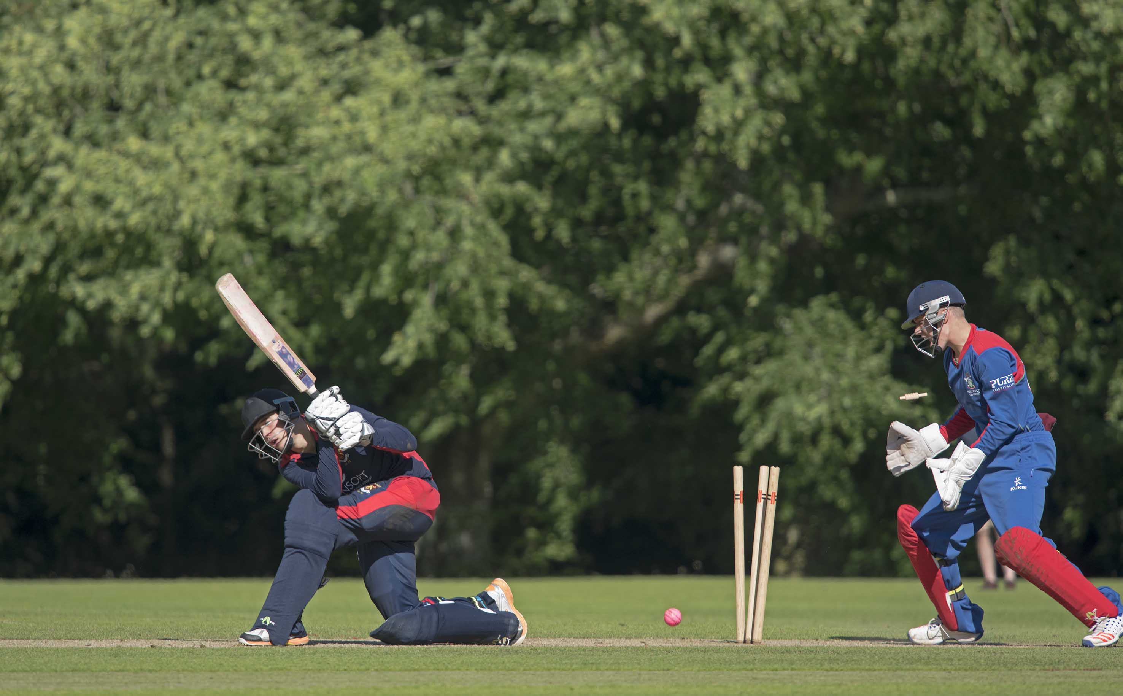
A. Cox (Felsted) is bowled by Bartlett for 2

Slide 31
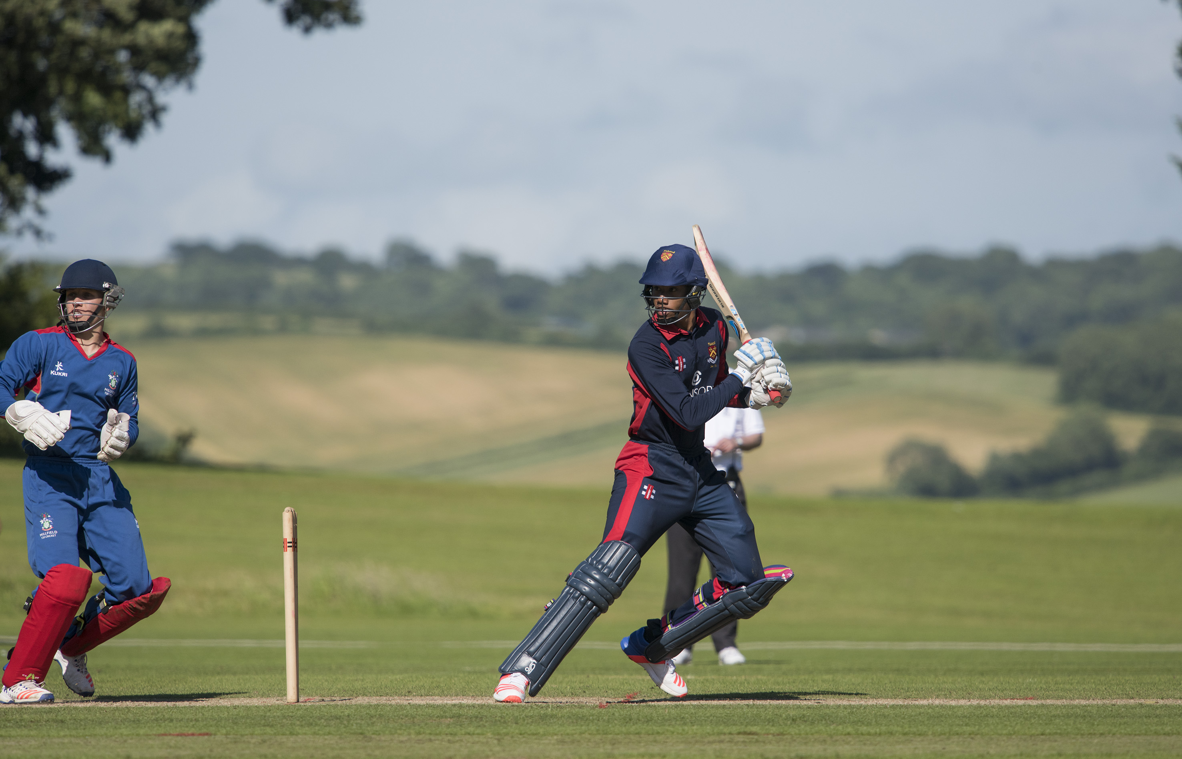
ARUNDEL - JULY 1: National Schools Twenty20 Finals Day 2016, the final Millfield v Felsted, Yvan Grant (Felsted) batting during bis 43
11608089
photograph by Patrick Eagar

Slide 32
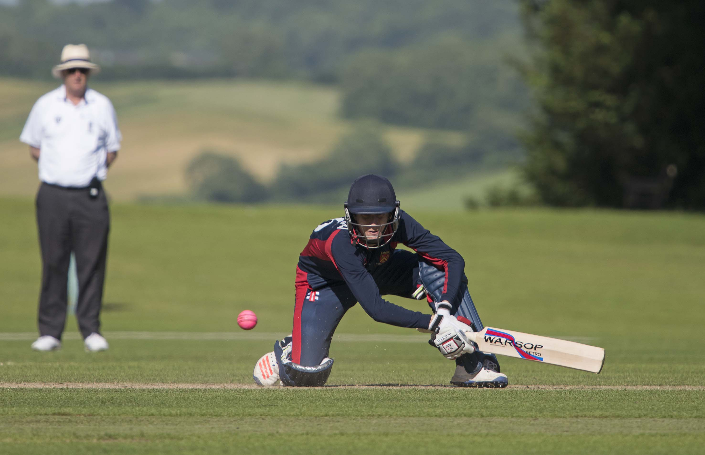
Buttleman (Felsted) improvises during his 28

Slide 33
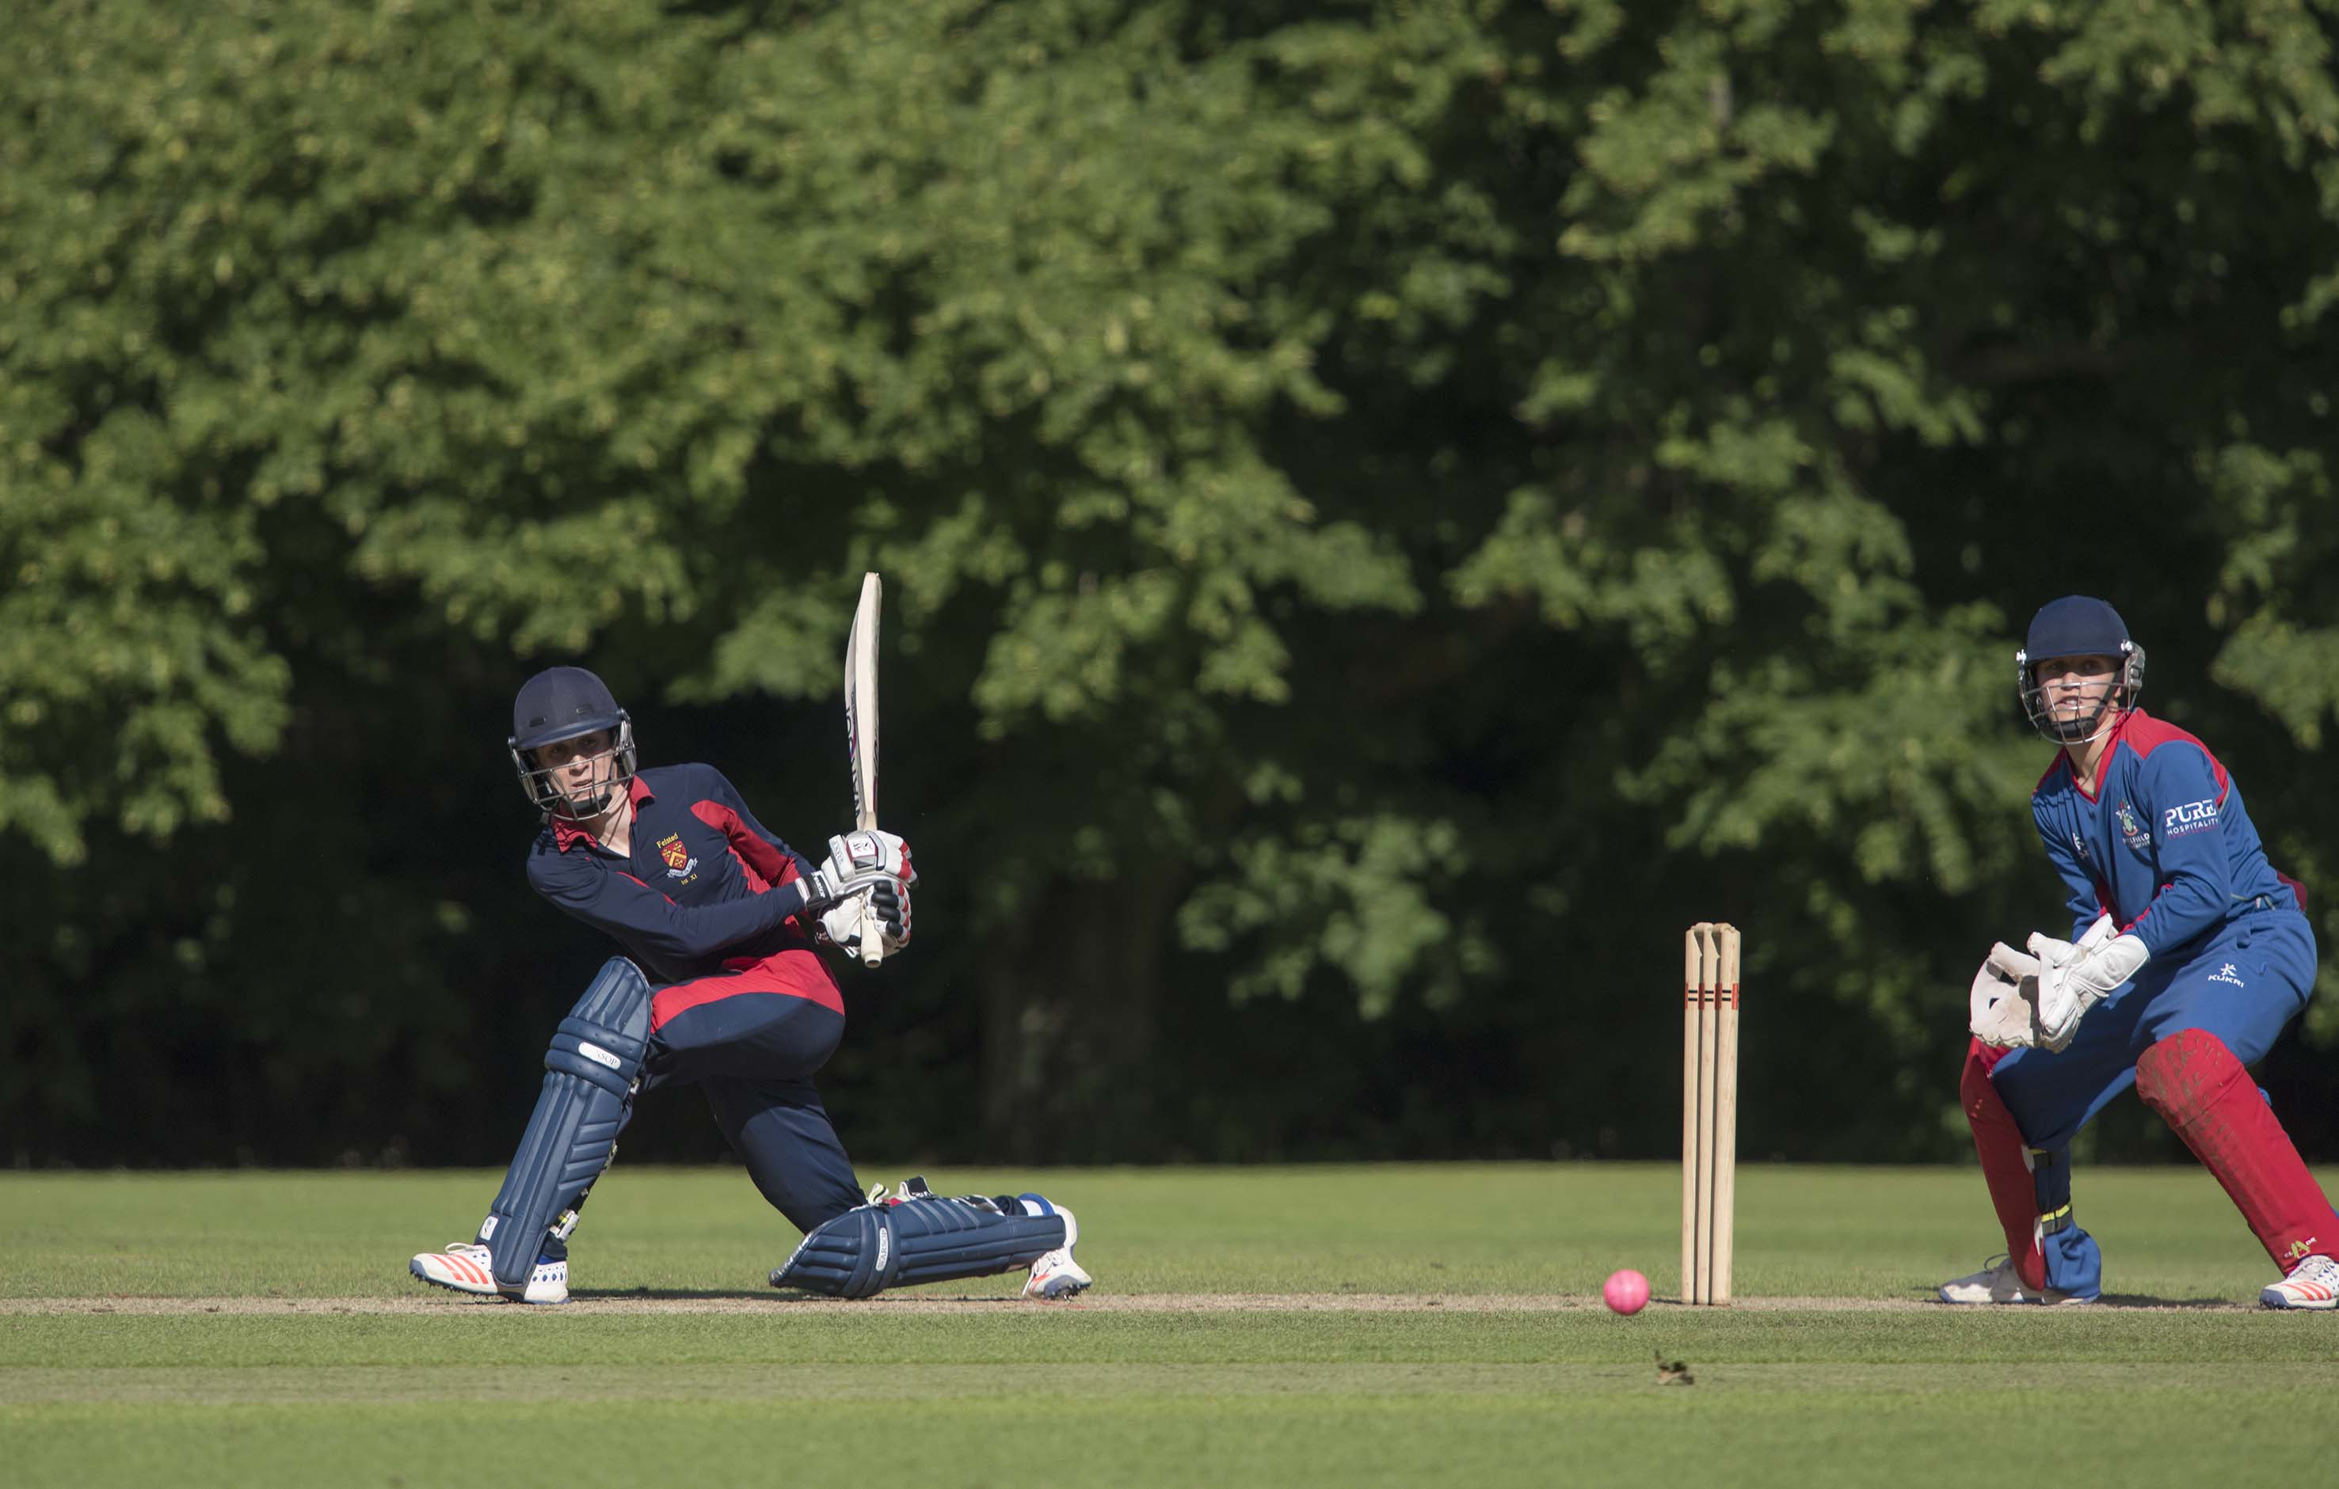
Felsted wicketkeeper William Buttleman sweeps during his 28

Slide 34
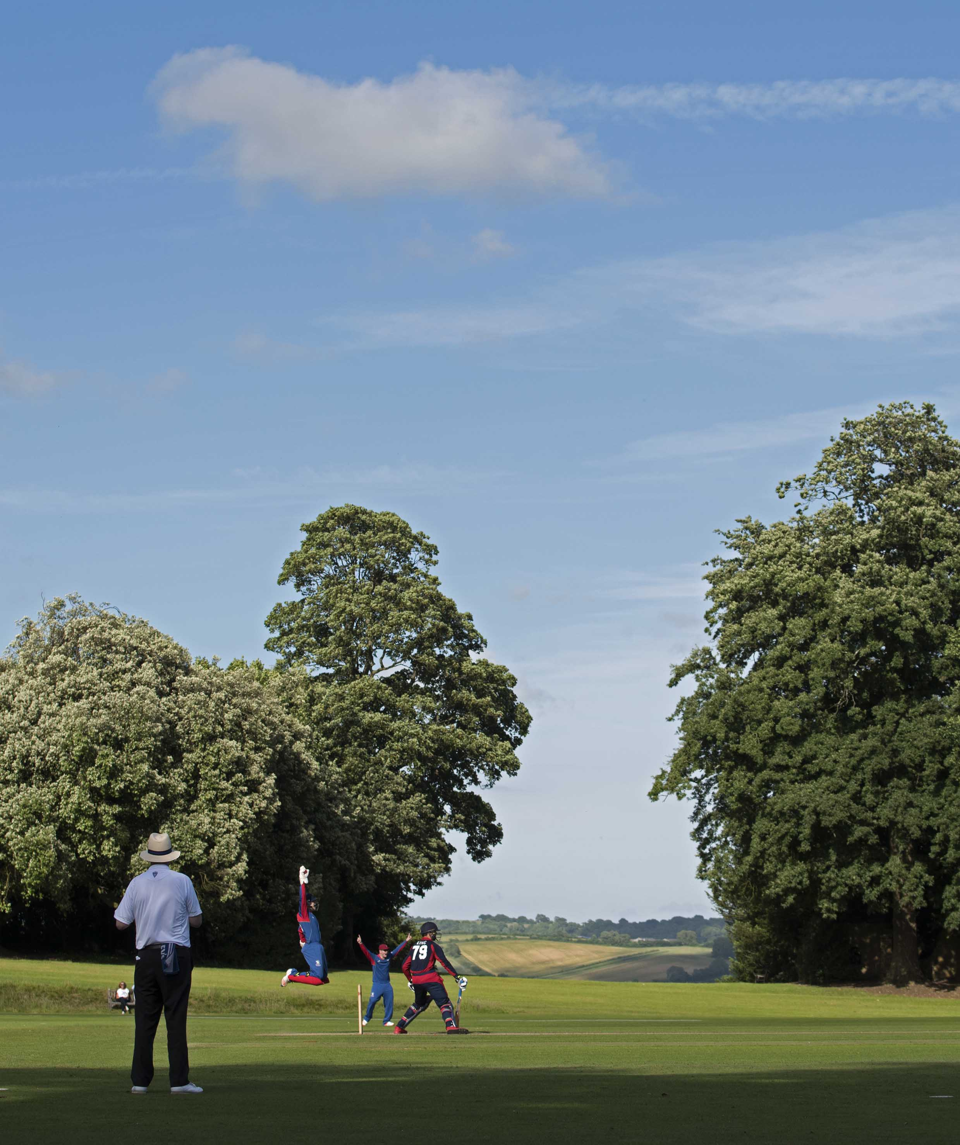
King (Felsted) is caught behind by Seward off Bevan for 0

Slide 35
The presentation by Johnny Barclay
former Captain of Sussex and President of MCC
2016 winners
Millfield

Slide 36
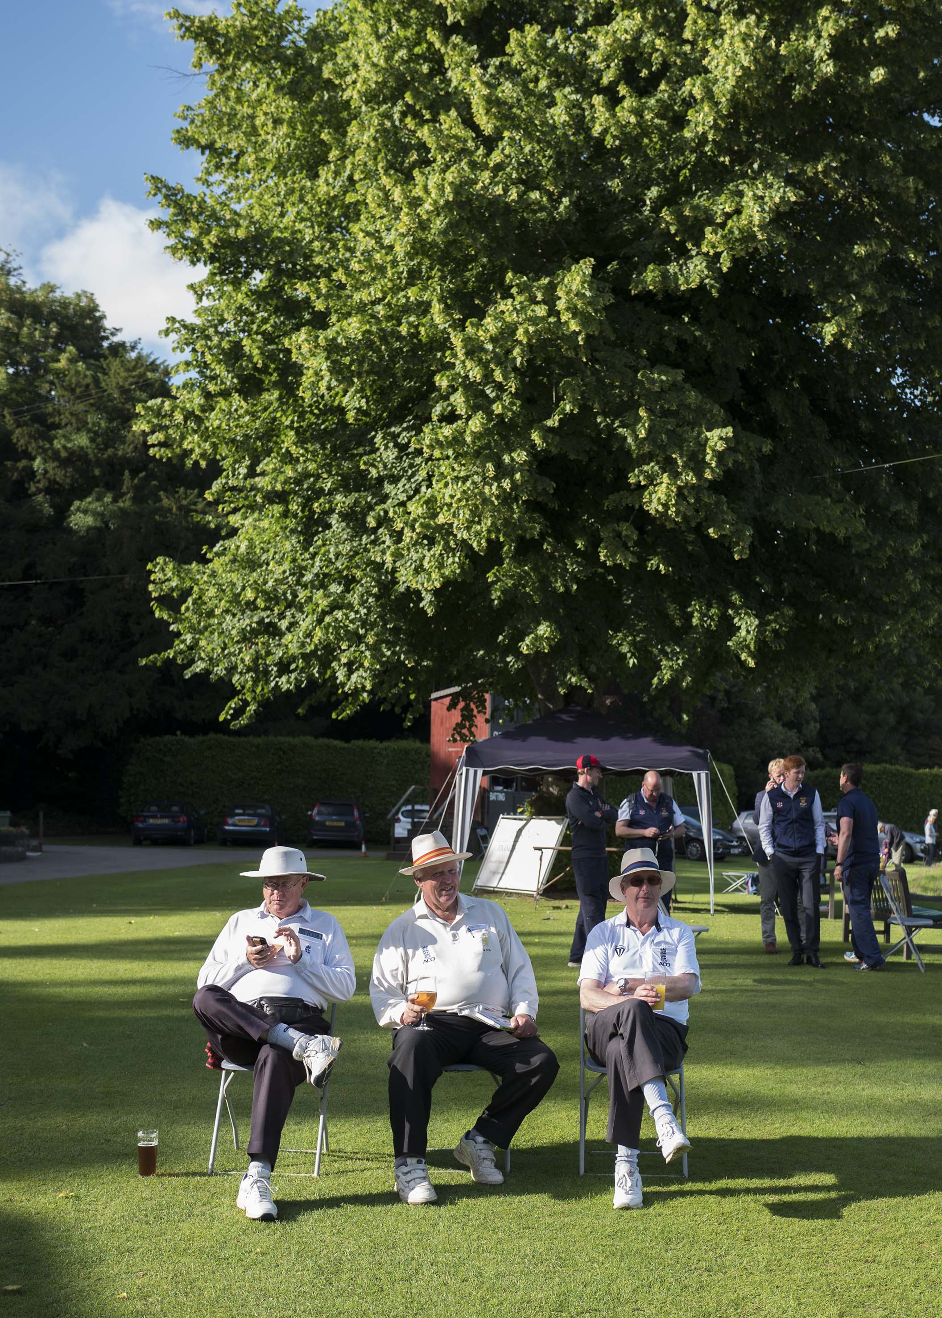
The umpires take a break after the final

Slide 37
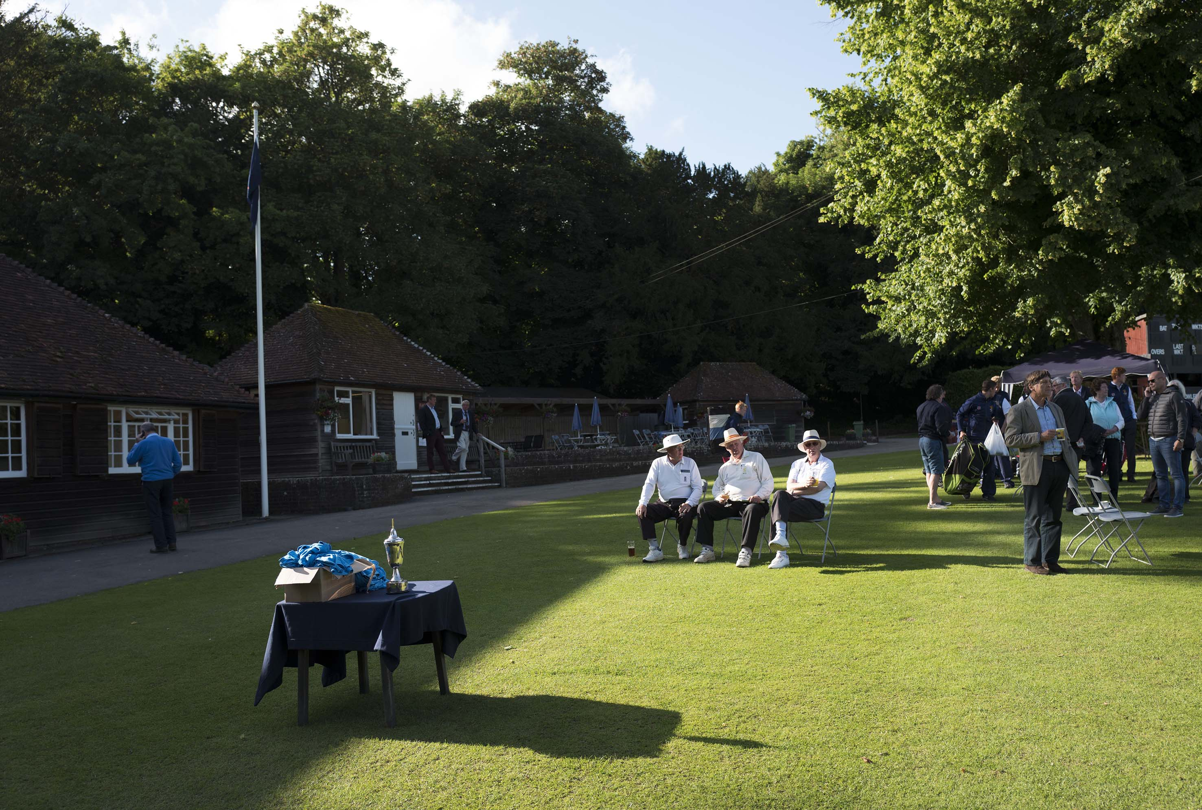
Umpires having a rest

Slide 38
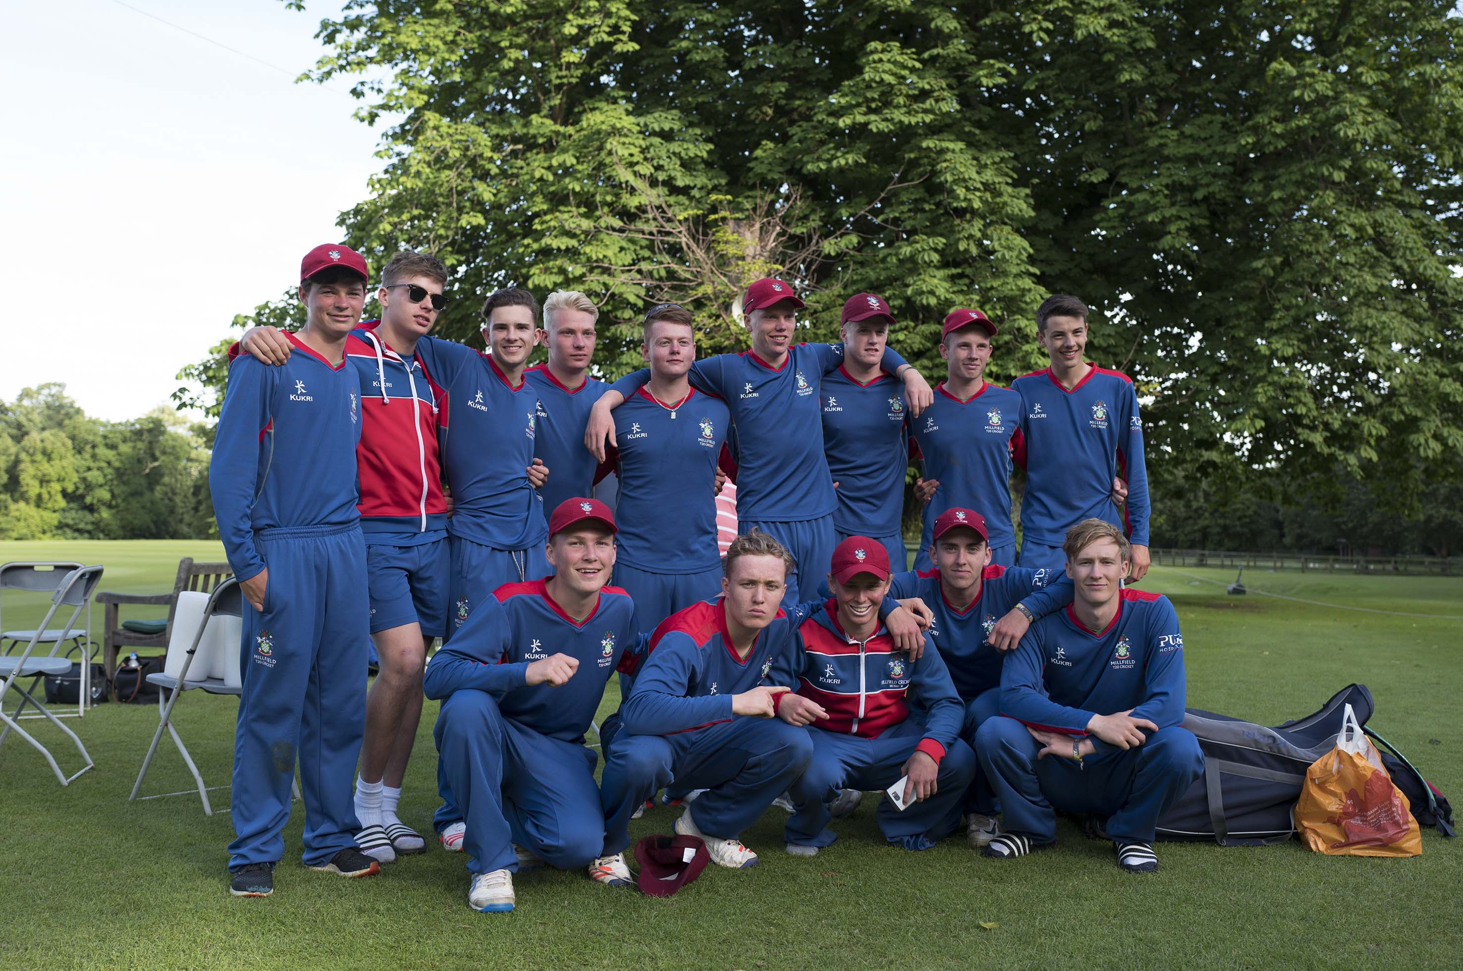
Millfield, winners of the 2016 competition

Slide 39
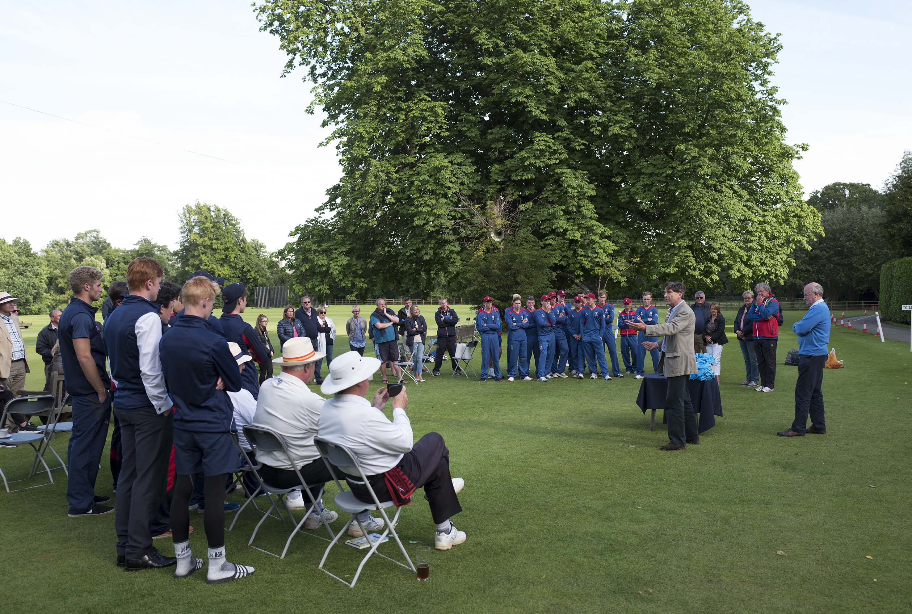
ARUNDEL - JULY 1: National Schools Twenty20 Finals Day 2016, the final Millfield v Felsted, Millfield the winners at prize giving.
11620365
photograph by Patrick Eagar

Slide 40
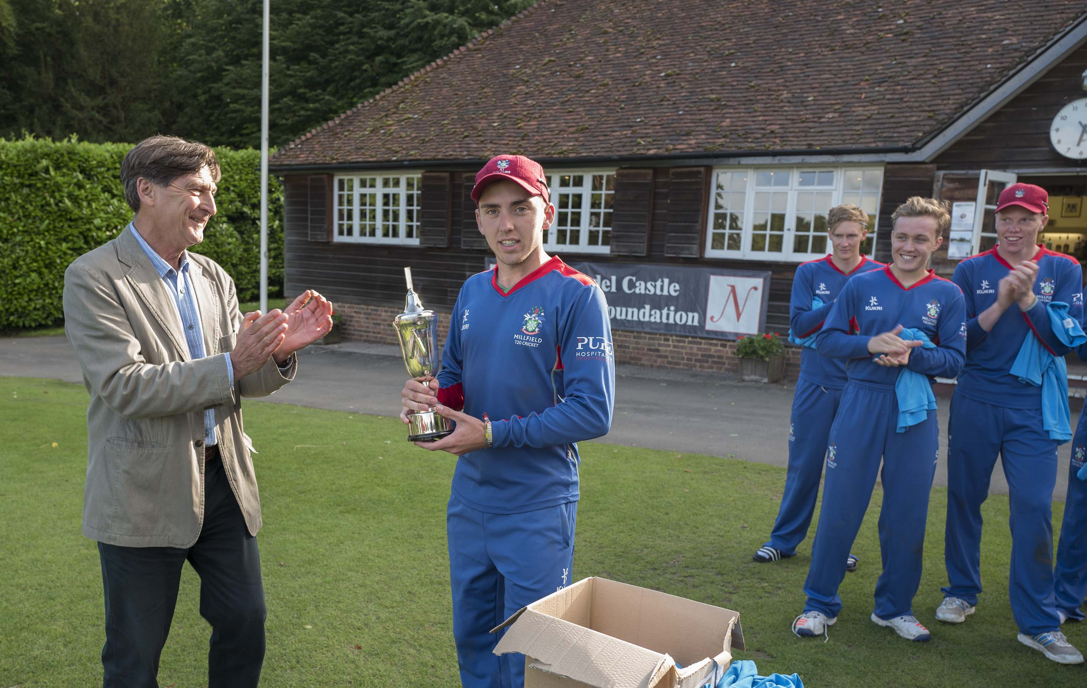
Thomas Lace (Millfield captain) with the trophy. Johnny Barclay is on the left.

Slide 41
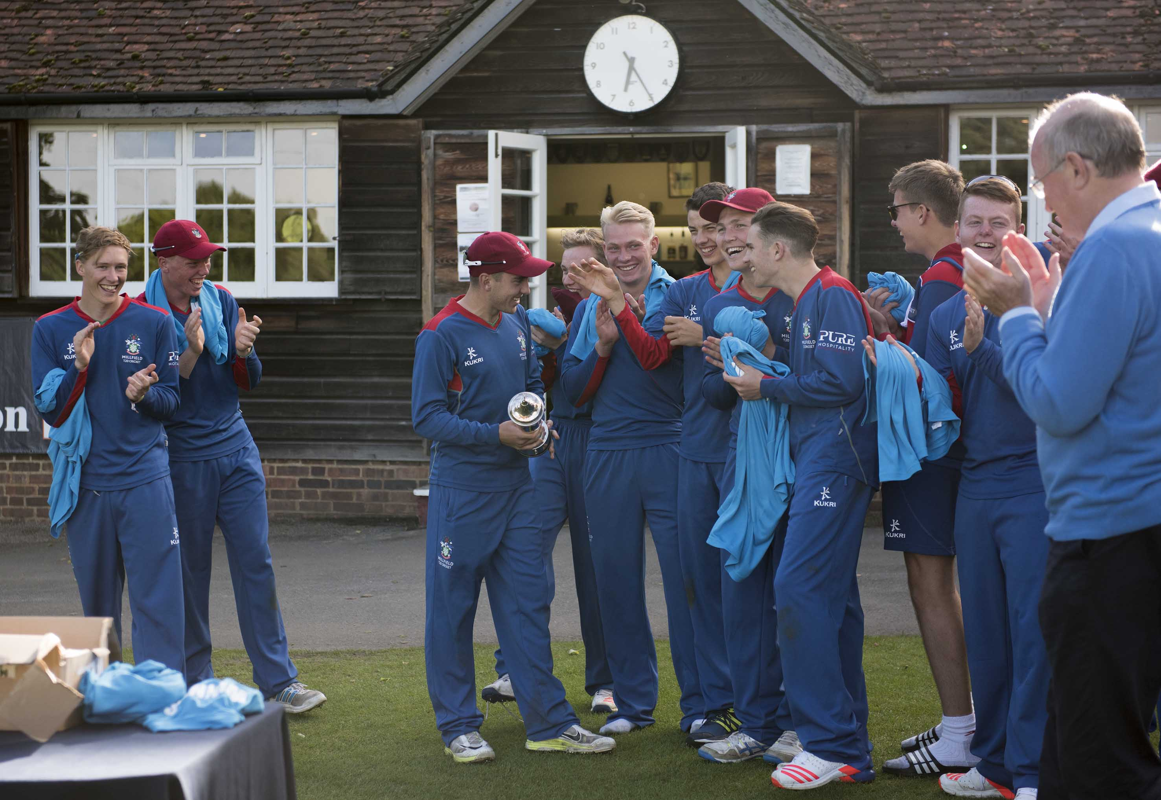
The eventual winners Millfield celebrate with the trophy

Slide 42
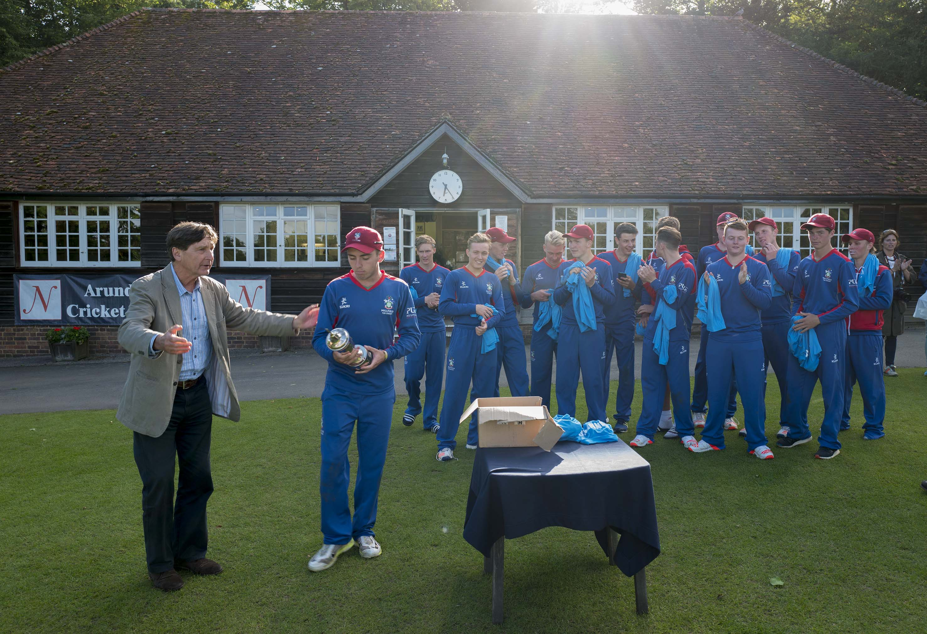
Johnny Barclay (left) with the winning Millfield team.

Slide 43
Photographs
by
Patrick Eagar
© No images may be reproduced without permission

Slide 44
National Schools Twenty20 competition
Finals day July 2016
Arundel Castle

